Slide 1

3 North Street
Future Use of Site
City Council Meeting – March 2, 2020

Slide 2
Presentation Overview
Purpose:
Provide the City Council with more detailed information related to the City-owned 3 North Street site to facilitate the Council being able to provide direction to staff on a preferred option to pursue for future use of the site.
Background:
At a City Council Work Session on January 21, 2020, the City Council considered whether to pursue a Community Pavilion-Farmers’ Market option or an Affordable Housing option for future use of the 3 North Street site.

Slide 3
Presentation Overview Continued
Background continued:
The City Council continued the January 21st 3 North Street site discussion, directing staff to return with additional information as follows to facilitate determining a future use of the site:
History and details related to the prior approval of a schematic plan for the Community Pavilion-Farmers’ Market at the 3 North Street site
The Park and Recreation Commission recommendation for future use of the 3 North Street site
Information about the potential for preparing a master plan for the West Plaza area, including the 3 North Street site

Slide 4
Presentation Overview Continued
Organization:
Staff has organized the information in this presentation related to the 3 North Street site around the following four topic areas:
City Policies and Codes Related to the Use of the 3 North Street Property;
Overview of the City’s Recent, Current, and Anticipated Production of Affordable Housing;
Potential for a SMART Station at the 3 North Street Site;
History of and the Current Proposal for Siting a Permanent Community Pavilion-Farmers’ Market at the 3 North Street Site.

Slide 5
City Polices and Codes Related to the Use of the 3 North Street Property
Notes:
Presenter: Steven Sotomayor

Slide 6
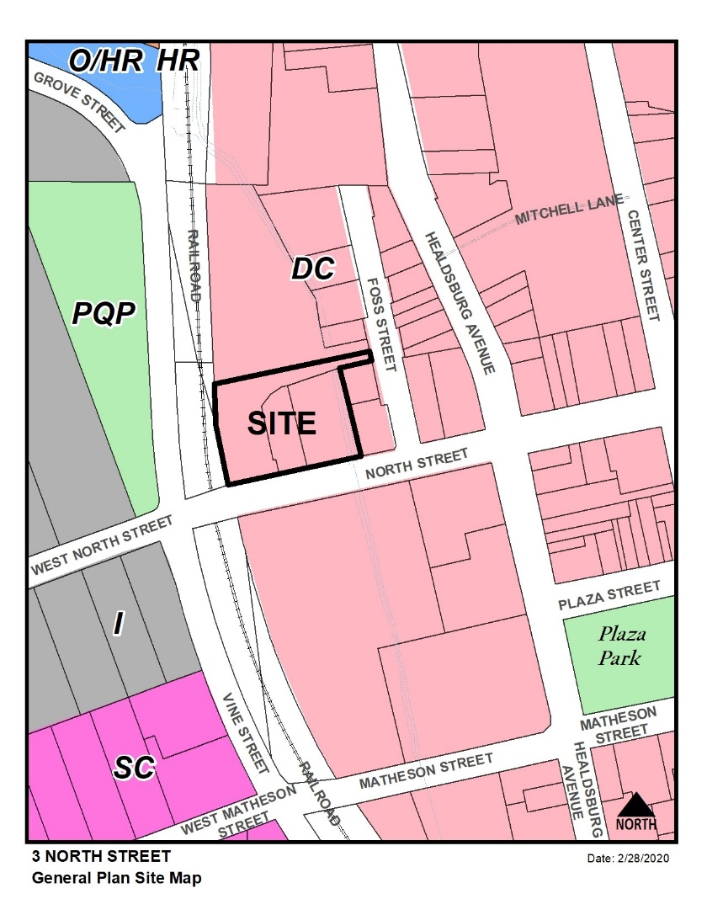
City Polices and Codes Related to the Use of the 3 North Street Property
Site Information
3 Parcels with combined area of 1.2 acres
Cerri building, Parking lot, Wetzel Native Plant Garden
General Plan Designation – Downtown Commercial (DC):
Provides for a broad range of Commercial and Office Uses
Residential Uses, 10-16 units per acre, permitted on same site when subordinate to an allowable Commercial Use

Slide 7
City Polices and Codes Related to the Use of the 3 North Street Property (Continued)
Applicable General Plan Policies:
Protect and Enhance the Downtown and its Plaza
Embrace the City’s Waterways
Protect and Enhance Qualities that Attract Visitors to the City
Land Use Code Classification – Downtown Commercial District (CD):
Provide appropriately located areas for Retail Stores, Offices, Service Establishments, Amusement Establishments and Wholesale Businesses, offering Commodities and Services required by residents of the city and its surrounding market area
Provide space for Community Facilities and Institutions that appropriately may be located in commercial areas

Slide 8
City Polices and Codes Related to the Use of the 3 North Street Property Continued
Special Purposes of Downtown Commercial (CD) District:
Maximize the efficiency of the City’s retail district by limiting or prohibiting uses that break the continuity of commercial frontage or are incompatible with an attractive pedestrian shopping area
Promote use of vacant buildings by permitting certain conditional uses
Surrounding Land Uses to 3 North Street Site:
Duchamp Hotel to the north
West Plaza parking lot to the south
Foss Creek and SHED retail building to the east
Railroad right-of-way and City Hall to west

Slide 9
City Polices and Codes Related to the Use of the 3 North Street Property Continued
Master Plan for the West Plaza Area:
Part of community’s core area for commerce to serve residents and visitors
Land uses should support a pedestrian orientation, vibrant business environment, and contribute to historic charm
Moving forward with development of the 3 North Street site in the near term would still allow opportunity in the future to master plan the adjacent 4+/- acre West Plaza parking lot area
A master plan for the West Plaza parking lot area could address possibilities there for housing and commercial uses related to the City’s 2019 Strategic Plan suggested Downtown Zoning and Density Study, SDAT’s master planning and housing recommendations, and work anticipated with the City’s next Housing Element update in 2022
Additionally, given SMART’s anticipated extension of rail service to the City of Healdsburg not occurring until at least 2024, there would be the opportunity finalize a location and design for a SMART platform in the area. The master planning effort could require 18-24 months to complete.

Slide 10
Overview of the City’s Recent, Current, and Anticipated Future Production of Affordable Housing
Notes:
Presenter: Steven Sotomayor

Slide 11
Goals and Priorities
FY 2018-2020 Council Goals
Address the housing needs of Healdsburg workers and residents by updating and implementing City housing policies to increase the inventory of workforce and affordable housing in our community.
City of Healdsburg 2020-2025 Strategic Plan
The Strategic Plan Community Workshop Survey demonstrated that Affordable Housing was the number one priority, by far, for the Healdsburg Community.
Strategic Initiative – 03: Expand Affordable Housing Opportunities
Implement the Housing Action Plan
Identify Funding Mechanisms
Preserve Existing Rental Units
Evaluate Options to Amend the GMO
Implement the Strategies of the Regional Strategic Plan Designed to Address Homelessness in Northern Sonoma County.

Slide 12
Housing Production
Housing Element and Regional Housing Needs allocation, or RHNA
Required housing production goals set by the State of California;
State-level requirements are then distributed through a methodology determined by the Association of Bay Area Governments;
Jurisdictions that do not meet their production requirements face penalties.
The City of Healdsburg Housing Action Plan
Adopted by the City Council in February of 2018
Establishes specific community housing goals that complement General Plan Housing Element Goals to be achieved by 2022
Community Needs
Ongoing needs of the Community & Continuous Evaluations
Housing Needs Calculator

Slide 13
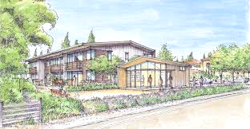

Affordable Housing Inventory
27 Properties
Across Healdsburg
40 Units
Preserved in the past Year
520 Affordable Units
$1.7 Billion Investment in Affordable Housing
90 Affordable Units In the Process of being Remodeled with a $9,000,000
Investment

Slide 14
Regional Housing Needs Allocation
The City of Healdsburg is required by the State of California to meet certain Housing Productions Goal
Income level | RHNA Allocation | 2015 | 2016 | 2017 | 2018 | 2019 | Total | Remaining
Very Low | 31 | 1 |  | 12 |  |  | 13 | 18
Low | 24 | 2 | 1 | 20 |  | 1 | 25 | 0
Moderate | 26 | 2 | 3 | 29 | 12 | 18 | 64 | 0
Above Moderate | 76 | 39 | 22 | 16 | 40 | 13 | 130 | 0
Total | 157 | 44 | 26 | 77 | 52 | 32* | 232 | 18
*31 total permits issued; 32 units created (duplex)
Totals do not include 39 units acquired by the City and Burbank Housing and the preservation of 1735 Palomino Court

Slide 15
Projected RHNA for 2023-2030
Based upon preliminary projections we anticipate a 100% increase in the RHNA for the Bay Area.
Income level | RHNA Allocation (2015-2023) | RHNA Allocation (2023-2030)
Very Low | 31 | 62
Low | 24 | 48
Moderate | 26 | 52
Above Moderate | 76 | 152
Total | 157 | 314

Slide 16
RHNA Projections 2015-2023
Income level | RHNA Allocation (2015-2023) | Current | Projected Units | Percentage of Allocation
Very Low | 31 | 13 | 37 | 119%
Low | 24 | 25 | 41 | 170%
Moderate | 26 | 64 | 71 | 273%
Above Moderate | 76 | 130 | 184 | 240%
Total | 157 | 232 | 333 | 212%

Slide 17
RHNA Projections 2023-2030
Income level | RHNA Allocation (2023-2030) | Projected Units | Percentage of Allocation
Very Low | 62 | 99 | 159%
Low | 48 | 124 | 258%
Moderate | 52 | 121 | 232%
Above Moderate | 152 | 292 | 192%
Total | 314 | 636 | 202%
Project | Above Moderate | Moderate | Low | Very-Low
Mill District | 125
North Village | 167 | 54 | 9 | 26
155 Dry Creek |  | 17 | 25 | 13
Saggio Hills |  | 25 | 45 | 30
Other Sites |  | 25 | 45 | 30

Slide 18
Housing Action Plan
The Housing Action Plan Objectives & Targets as defined for the 2017-2022 timeframe.
Increase the Quantity of Deed Restricted Affordable Housing HAP GOAL
Encourage and Facilitate Private Development of Accessory Dwelling Units
Develop Middle Income Housing
Encourage Multifamily Rental Units
Encourage Development of Mixed Product Types
92 Since 2017
216 Projected By 2022
200 New Units By 2022
40 Since 2017
100 Projected By 2022
125 New Units By 2022
70 Units Since 2017
135 Projected By 2022
135 Units By 2022
161 Since 2017
285 Projected By 2022
100 Units By 2022
118 Since 2017
TBD Based on Total Development
50% of all Units
Notes:
ADU is based upon a projection that we will develop 15 units per year until 2023.
Important to note that we may not meet the HAP objective of units that average less than 850 sq ft.

Slide 19
Potential for SMART Station at 3 North Street Site
Notes:
Presenter: Steven Sotomayor

Slide 20
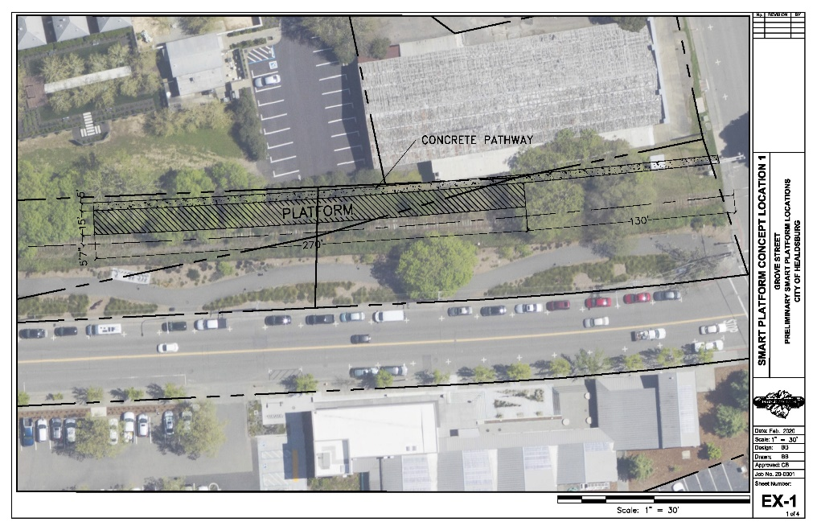
Potential for SMART Station at 3 North Street Site
SMART Station/Platform Concept Location Exhibit
City Public Works staff coordinating with SMART
Appears feasible to locate station platform at this location
Public access/sidewalk easement for SMART may be necessary on 3 North Street site
Additional detailed design and coordination with SMART is necessary

Slide 21
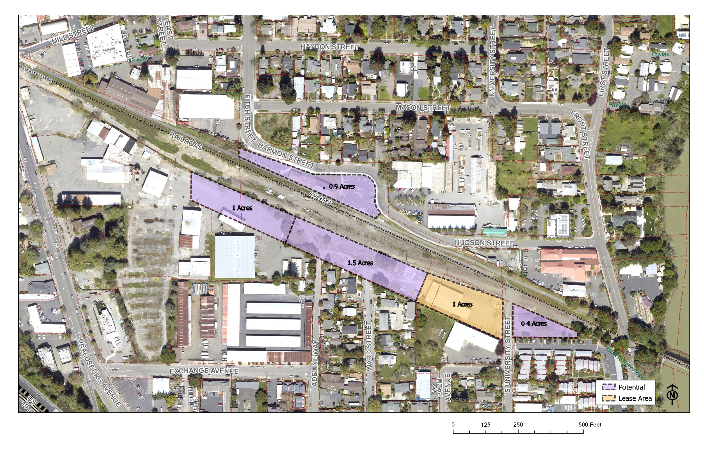
SMART Controlled Properties at Depot Site
SMART Staff is open to discuss possible affordable housing site in area, but will require action of SMART Board of Directors

Slide 22
3 North Street – Community Pavilion-Farmers’ Market
Notes:
Presenter: Steven Sotomayor

Slide 23
3 North Street – Community Pavilion-Farmers’ Market
Presentation Content
Site History
The City’s Purchase and Initial Planning Efforts
2015-2017 Planning Process
Concept Design
Schematic Design
Environmental Analysis Summary
Project Cost Estimates
Operational Considerations
Case Studies
Operating Model Scenarios
Operating Budget Scenarios
The Farmers’ Market Fit
Operating Parameters/Hours of Operation
Fundraising Efforts
Naming Partner Pledge – Foley Family Foundation
Parks and Recreation Commission Recommendation

Slide 24
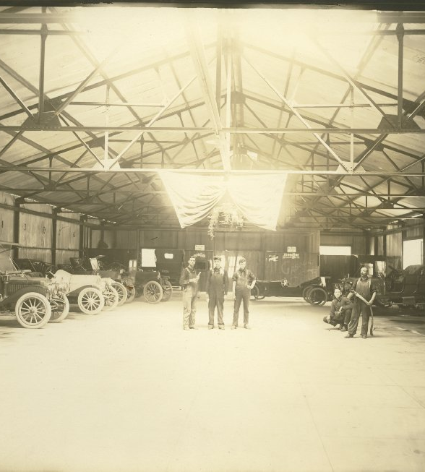
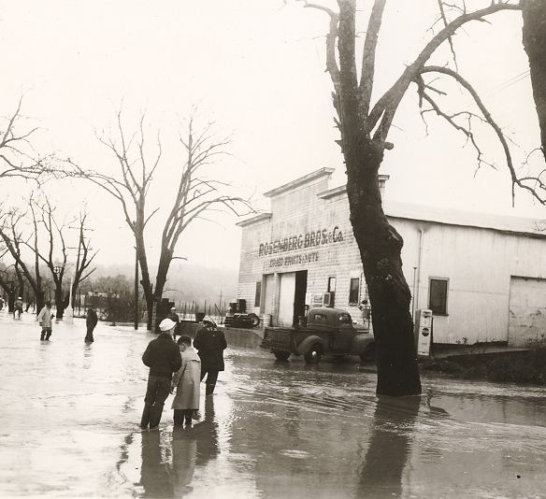
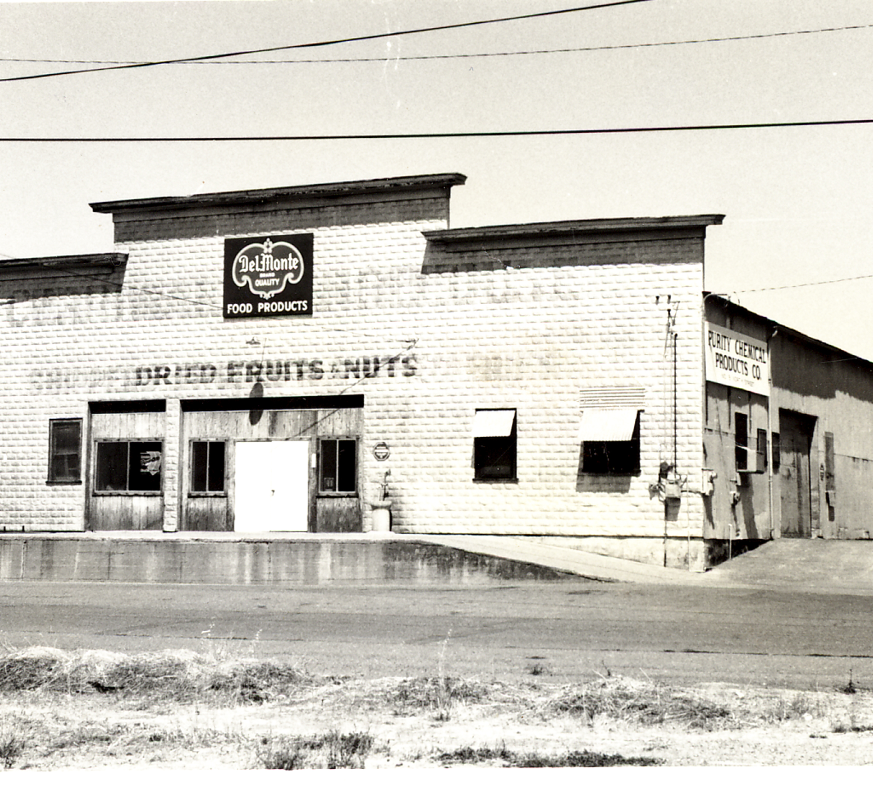
3 North Street – Community Pavilion-Farmers’ Market
Site History
Site was developed prior to 1920
Initially fruit and nut packing and distribution
Later Purity Chemical Products (agriculture and pool/spa products)

Slide 25
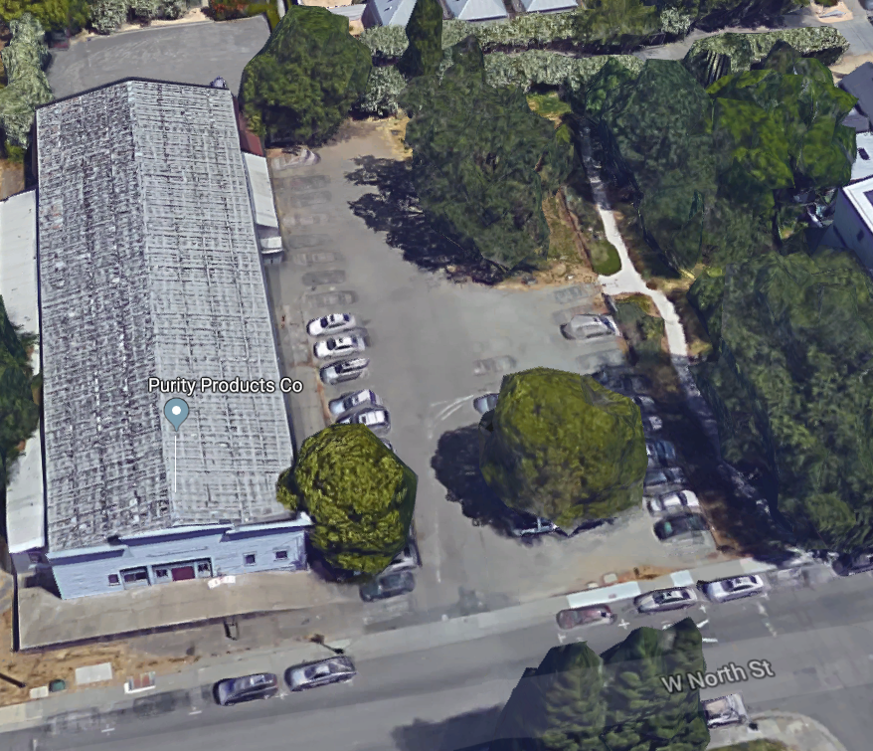
3 North Street – Community Pavilion- Farmers’ Market
City Purchase/Initial Planning Efforts
2004: Purchased by the City to help meet parking needs
2007: RDA Board directed staff to initiate removal of the building with possible preservation of the façade attached to a shade structure
Community opposition to the demolition of the building and other factors caused the City to reconsider redevelopment plans for the site

Slide 26
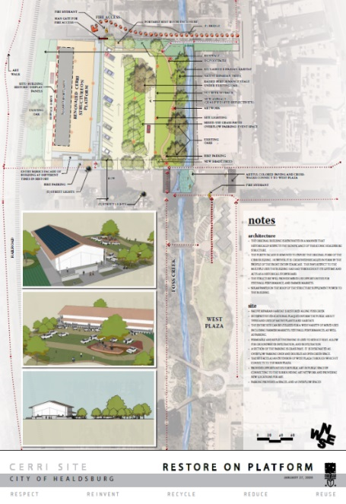
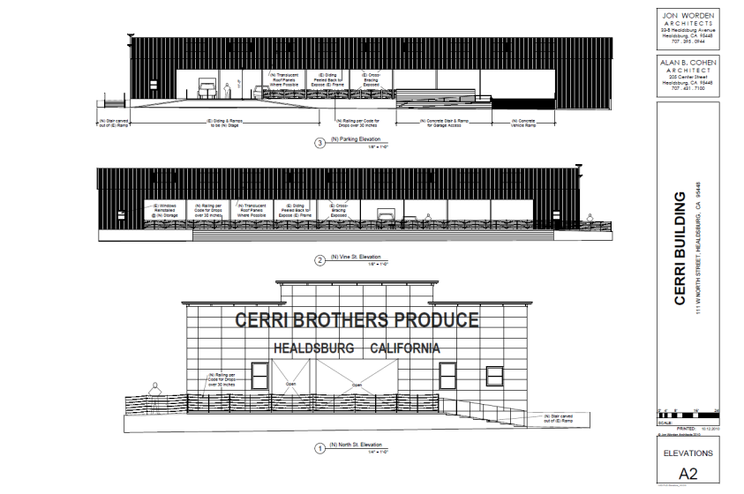
3 North Street – Community Pavilion- Farmers’ Market
City Purchase/Initial Planning Efforts
Different concepts proposed by Carducci, Worden Cohen
Recession and dissolution of Redevelopment Agencies by the State stopped work on the project

Slide 27
3 North Street – Community Pavilion- Farmers’ Market
Concept Design (2015-2016)
June 15, 2015 - City Council provided the following direction to guide the concept design process:
The site should provide parking
The site should be the home of the Healdsburg Farmers Market
In developing the concept design options, consider space for community events and activities
Develop two concept design options:
Retain the existing building and renovate/repurpose
Remove the existing building and reconstruct the site with parking and shade structure(s)
Identify ways to incorporate green building technology, including solar.
Return to Council if public process raises ideas that require Council’s consideration.

Slide 28
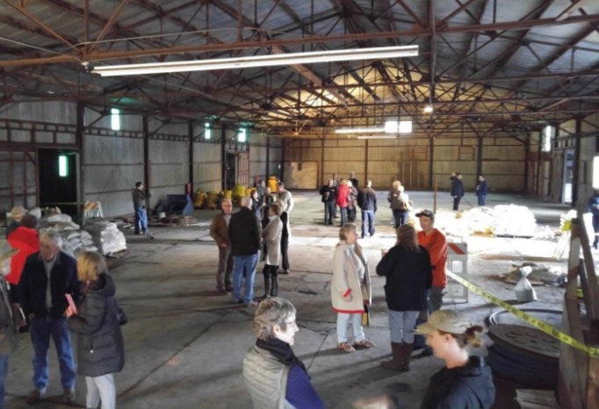
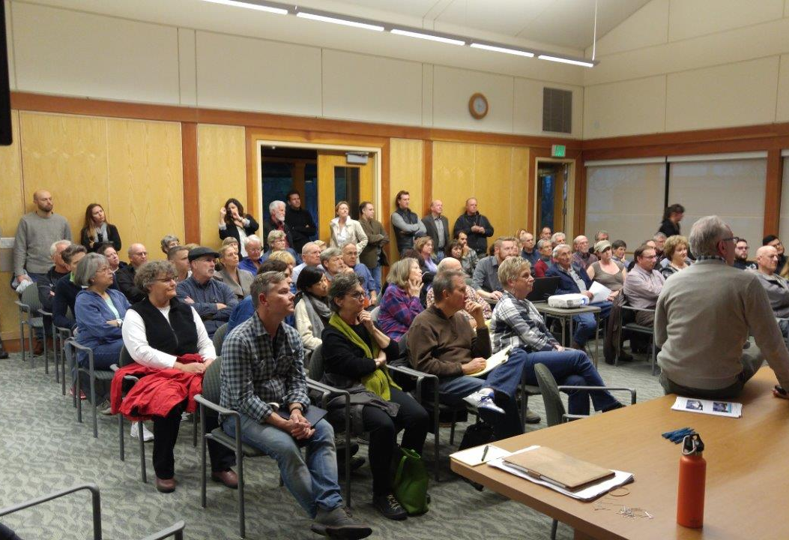
3 North Street – Community Pavilion- Farmers’ Market
Concept Design Public Input
City Council received five presentations on the project
The City conducted five focus group sessions (Farmers Market Board, Friends of the Farmers Market, the Arts Community, the Downtown Businesses/Chamber of Commerce, and a follow-up with the Farmers Market Board)
The City held two public open houses for the community to tour the site
The Parks and Recreation Advisory Commission received two reports on the project

Slide 29
3 North Street – Community Pavilion- Farmers’ Market
Concept Design Public Feedback
Parking is a major concern for the downtown area and needs to be a core function of the site
The Farmers Market is in favor of removing the building and constructing a new surface parking lot with agrarian shade structure
Majority of community input is in favor of saving the building
The community has strong support for the Farmers Market: are there ways to modify the design to work better for the Farmers Market?
Should enhance the connectivity and use of the Wentzel Garden as part of this project
Incorporate solar into the project

Slide 30
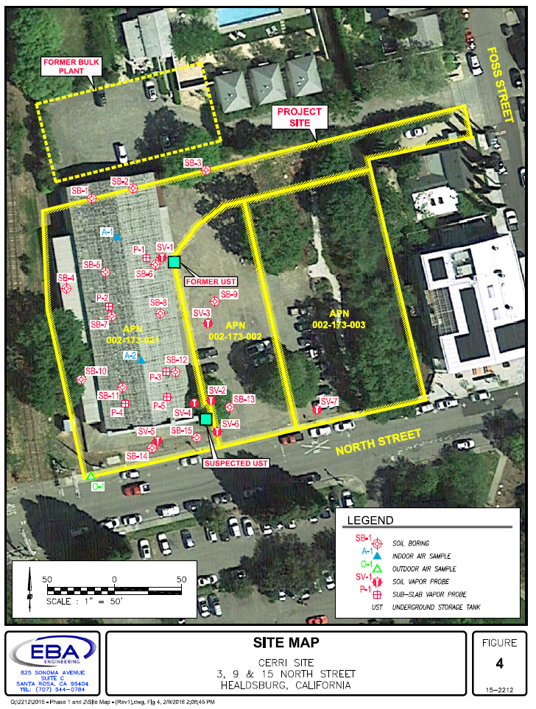
3 North Street – Community Pavilion- Farmers’ Market
Environmental Analysis (Phase 1 and Phase 2 Environmental Site Assessment)
Previously documented underground storage tank leak east side of building; leave in place if structure in area remains
Discovered new underground storage tank leak SE side of building; minor cleanup
Low levels of copper and lead on concrete slab inside building; can be address through engineering design
PCE in soil vapor in same area as SE underground storage tank leak; cleanup of underground storage tank will also address this area
No ground water contamination on the site

Slide 31
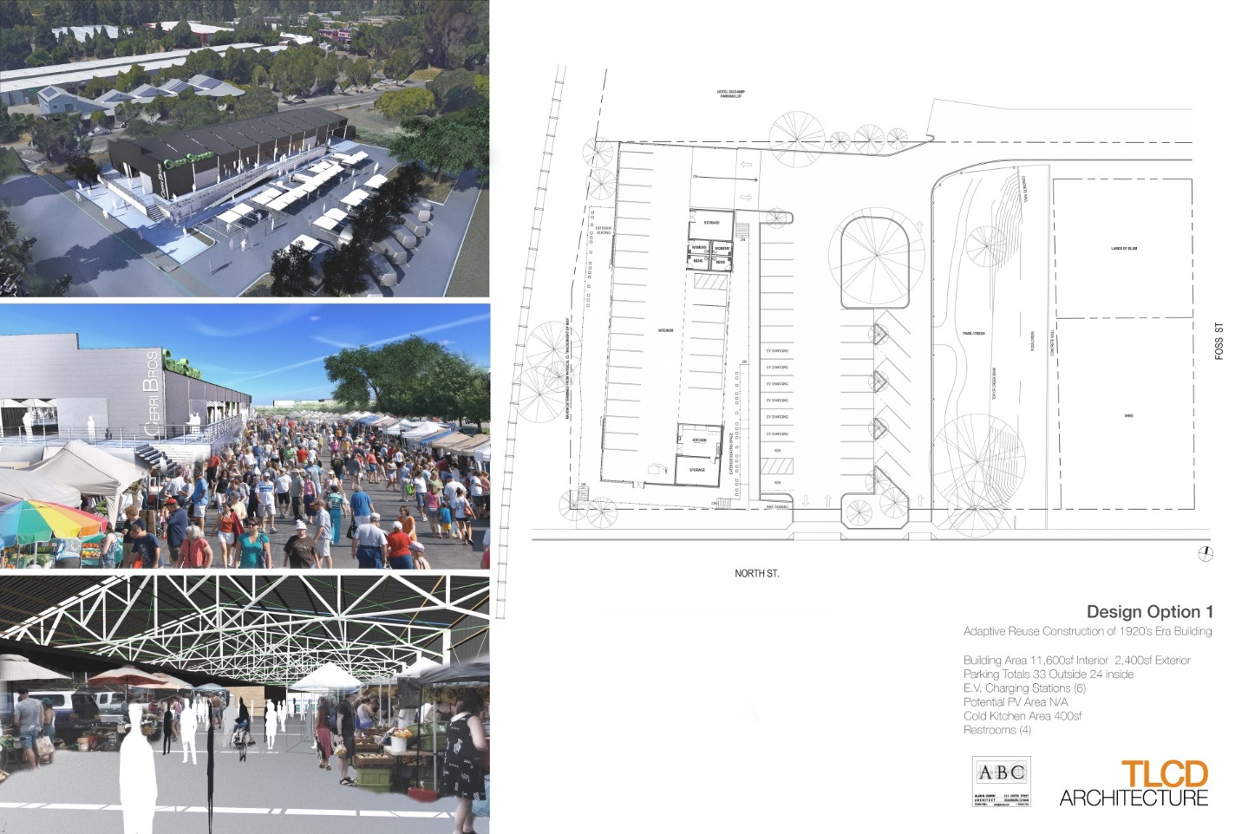
3 North Street – Community Pavilion- Farmers’ Market
August 15, 2016
Concept Designs
Option 1:Renovate and Repurpose

Slide 32
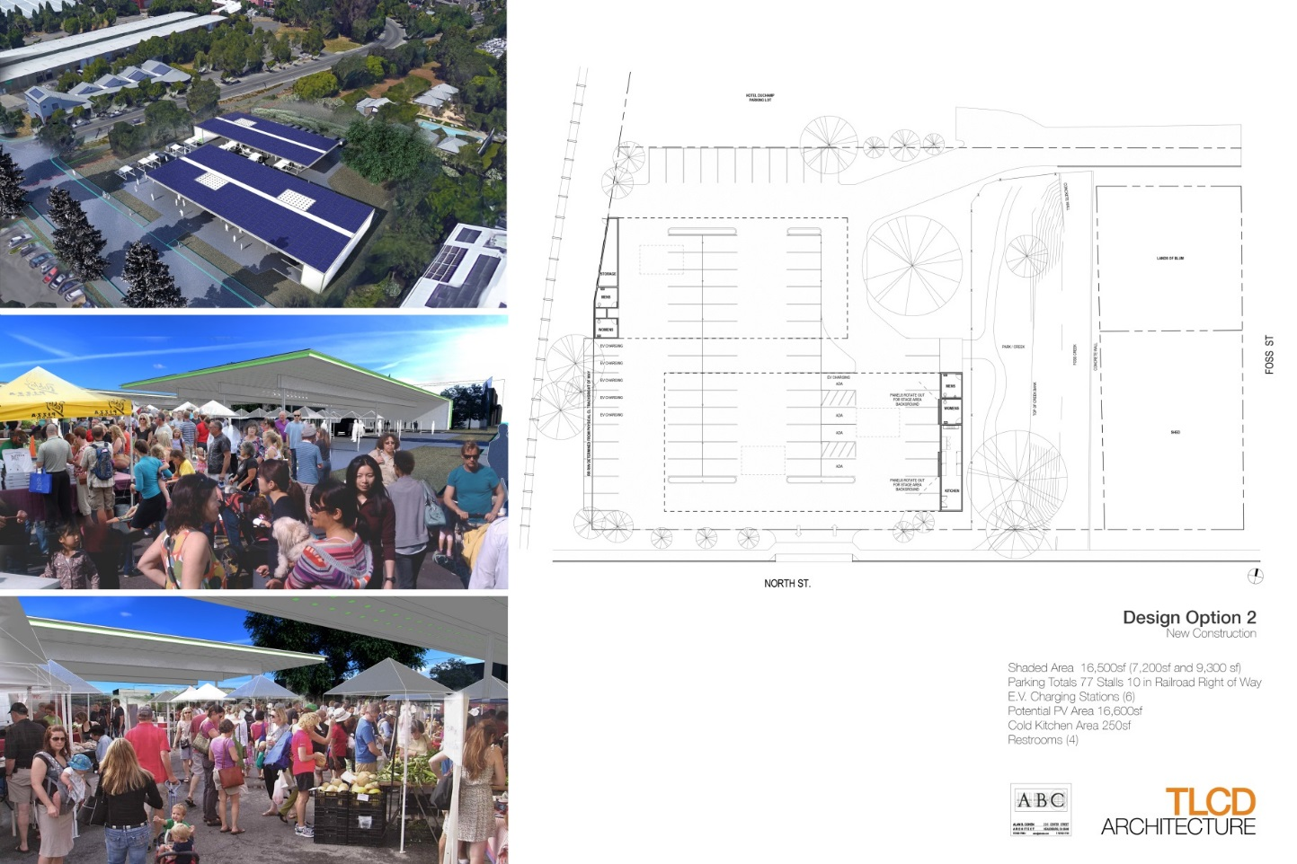
3 North Street – Community Pavilion- Farmers’ Market
August 15, 2016
Concept Designs
Option 2a: Remove and Reconstruct (Modern)

Slide 33
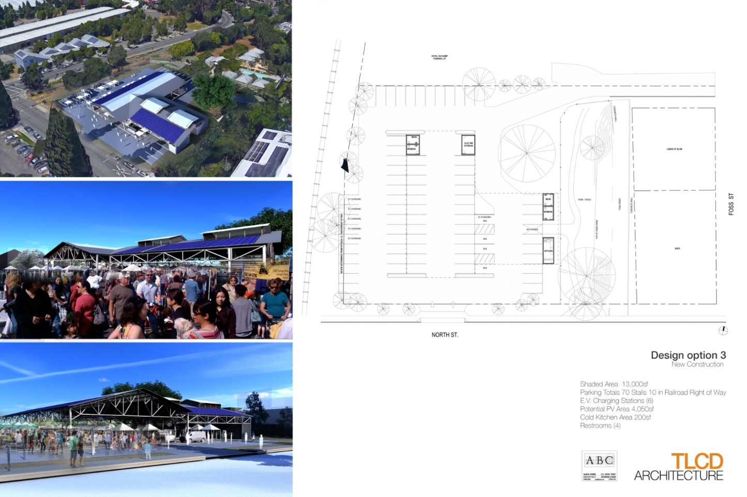
3 North Street – Community Pavilion- Farmers’ Market
August 15, 2016
Concept Designs
Option 2b: Remove and Reconstruct (Agrarian)

Slide 34
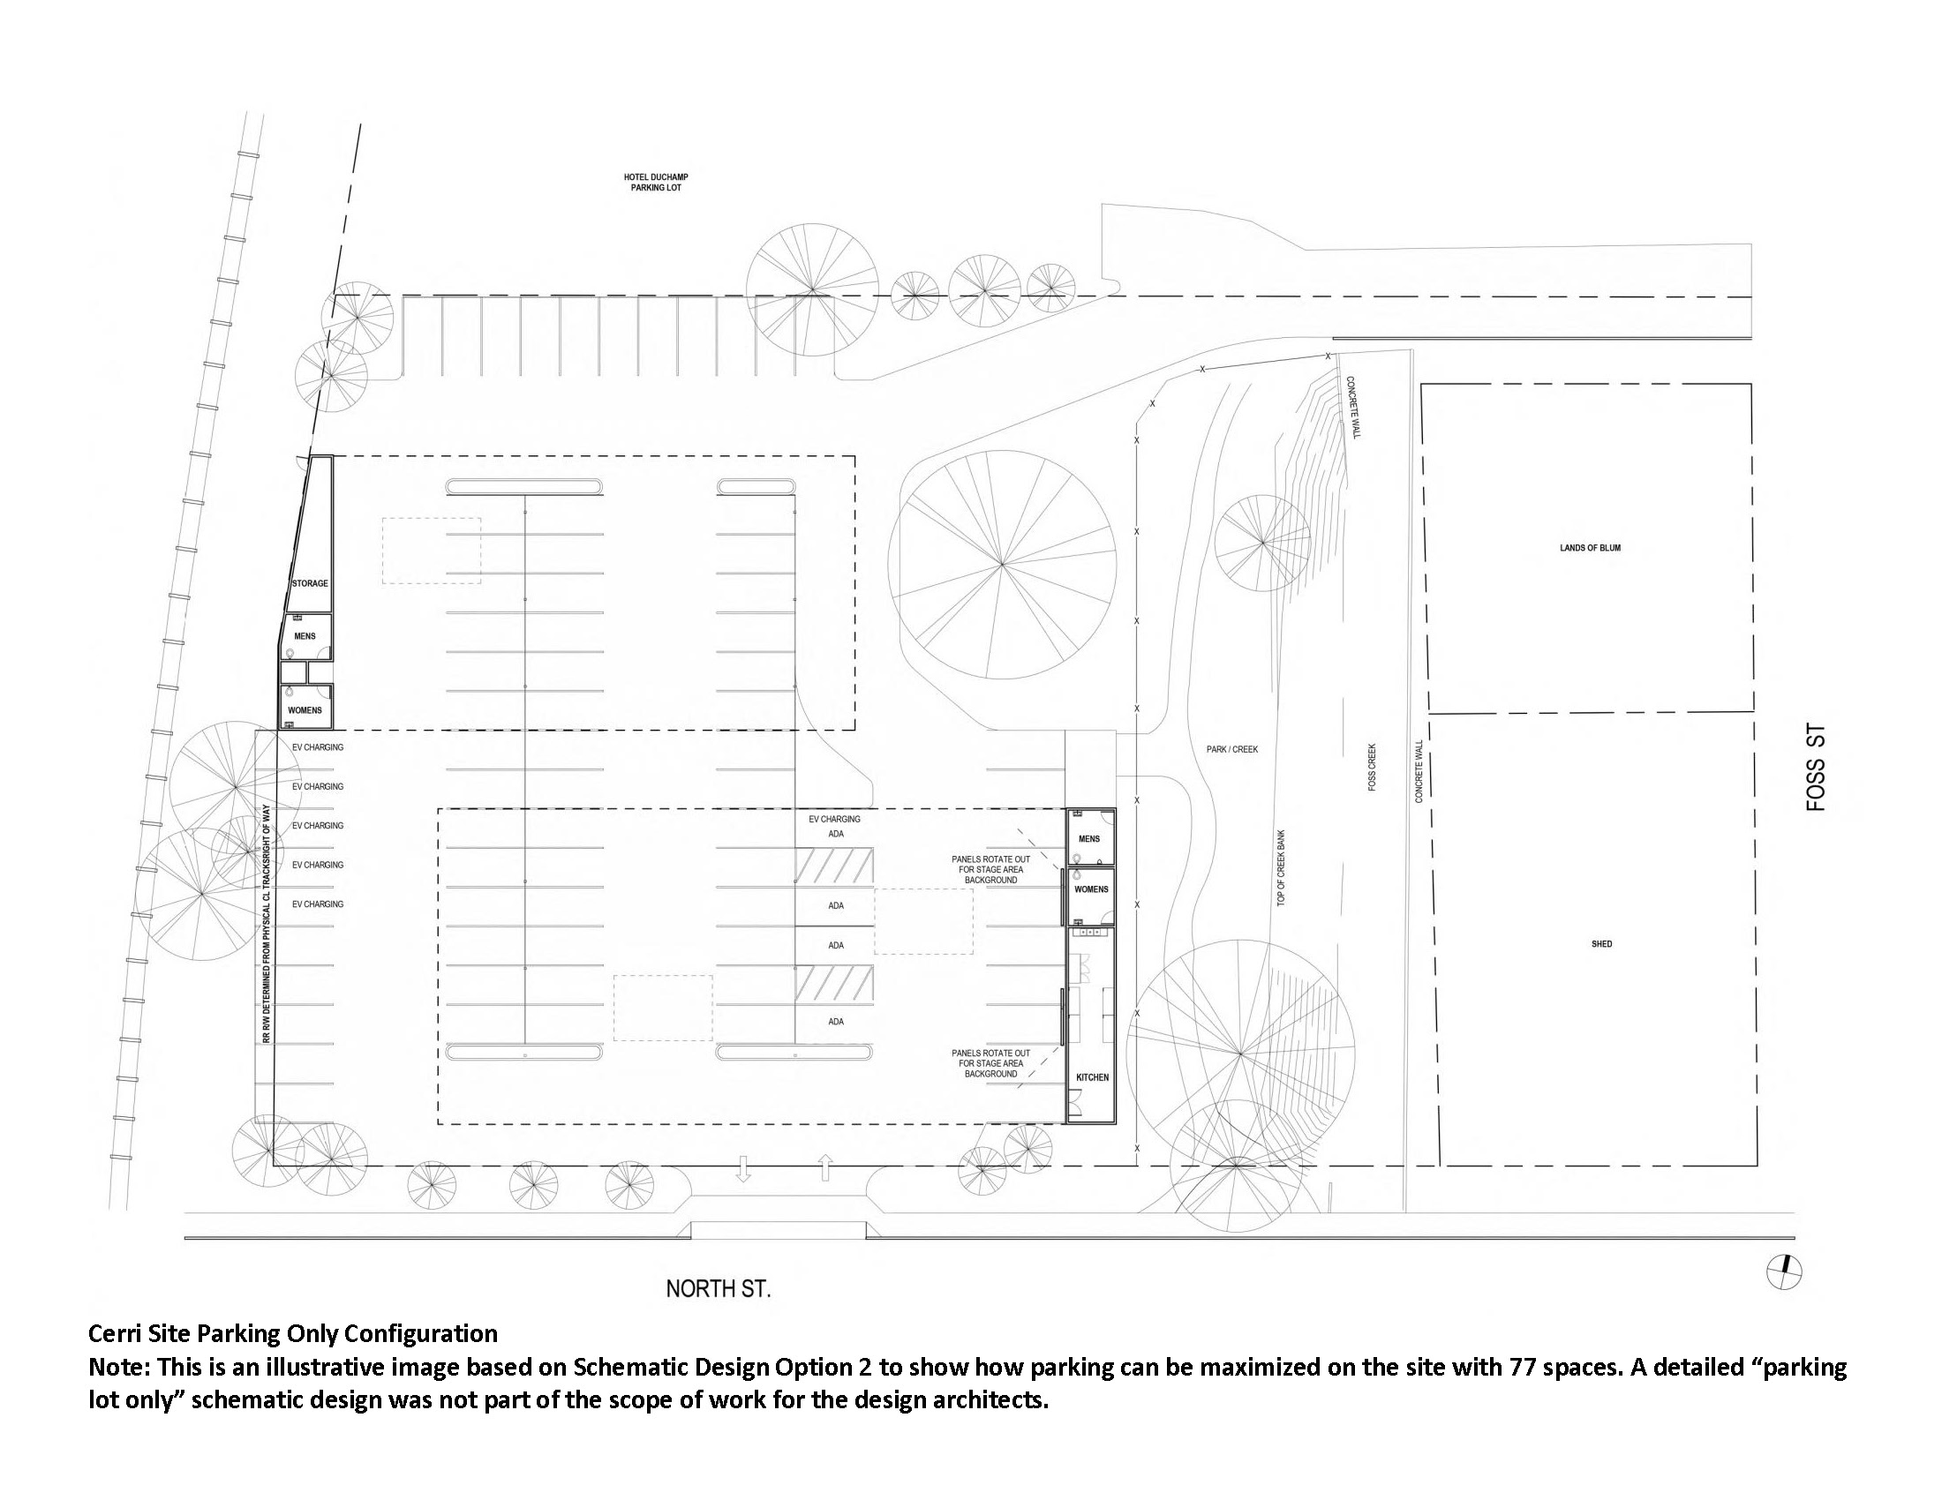
3 North Street – Community Pavilion- Farmers’ Market
August 15, 2016
Concept Designs
Option 3: Removal of Structure; Parking Only

Slide 35
3 North Street – Community Pavilion- Farmers’ Market
August 15, 2016 Council Direction
Proceed into schematic design that:
Maximizes parking
Preserves the façade and a portion of the building
Includes bathrooms and a kitchen
Can be implemented in phases
Uses an ecologically friendly surface for the parking lot surface

Slide 36
3 North Street – Community Pavilion- Farmers’ Market
Implementation of Council Direction (2016-2017)
Added Andie Cochran Landscape Architect to the team – focus on site analysis
Analyzed how best to maximize parking on the site
Considered the advantages/disadvantages of preserving the front versus the rear portion of the structure
Discussed where the façade should be placed
Evaluated whether some of the more prominent architectural elements of the structure could be repurposed
Held additional focus groups and a fourth public open house

Slide 37
3 North Street – Community Pavilion- Farmers’ Market
Schematic Design Review and Approval
April 12, 2017: Parks and Recreation Commission recommended approval
May 15, 2017: City Council approved the design and directed staff to move into design review and to come back with funding options and a phasing program

Slide 38
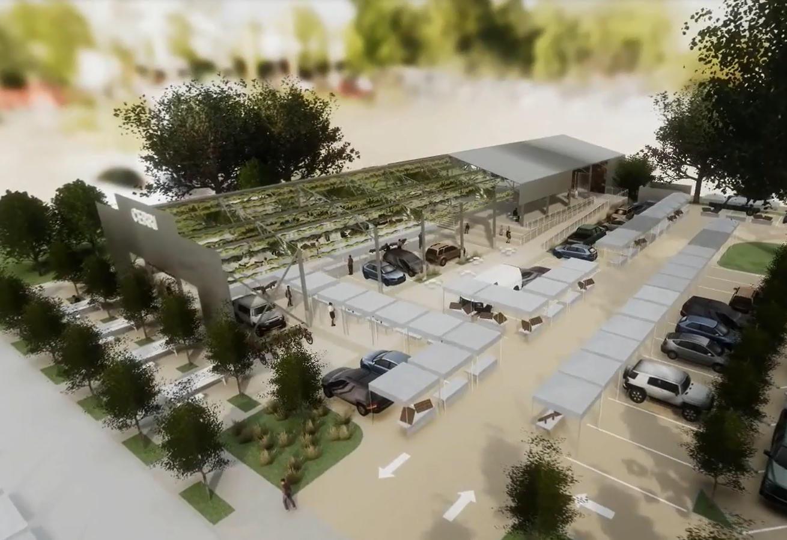
3 North Street – Community Pavilion- Farmers’ Market
Approved Schematic Design
55 parking spaces
Repurposing the existing structure to include approximately 5,200 square feet of “pavilion” covered space for events and activities, with an additional 6,100 square feet of multi-purpose parking and "open air" event space
A catering kitchen and restrooms
Secondary unloading and loading area on the west side of the site for staging events and activities
Single vehicle entry point to minimize potential pedestrian/vehicle conflicts
Emergency vehicle access to Foss Street

Slide 39
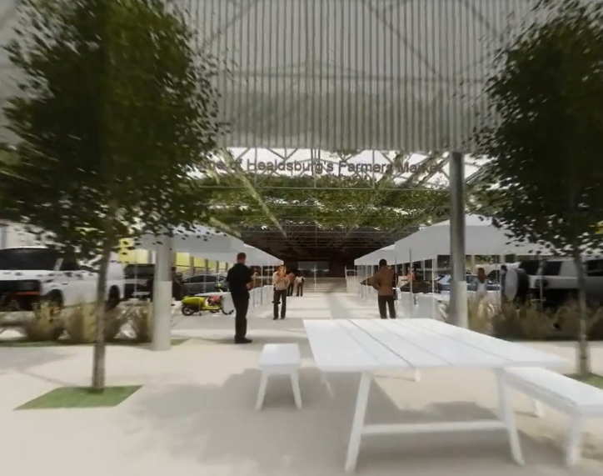
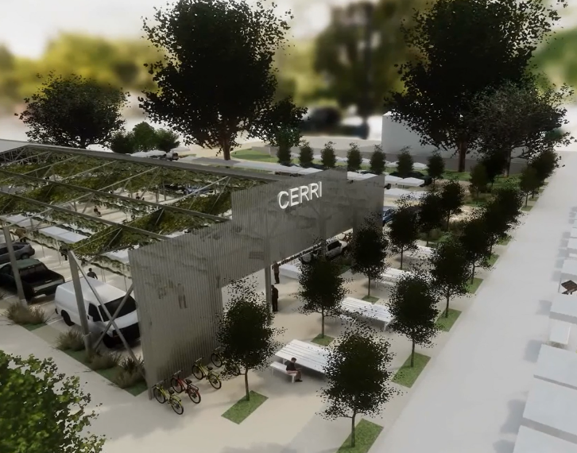

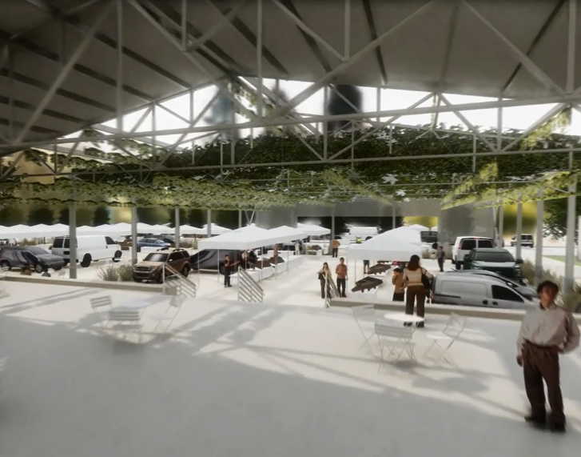
3 North Street – Community Pavilion- Farmers’ Market
Approved Schematic Design

Slide 40
3 North Street – Community Pavilion- Farmers’ Market
Approved Schematic Design Cost Estimate
$5.3 million (2017)
Construction
Soft costs such as design and permitting
15% contingency
The anticipated cost for construction in 2021 is approximately $6.5 million - $7 million

Slide 41
3 North Street – Community Pavilion- Farmers’ Market
Operational Considerations
Case Studies
Operational Models
Park Pavilion
Event Center
Operating Budget Scenarios
Farmers’ Market Fit
Operating Parameters (Hours of Operation)

Slide 42
3 North Street – Community Pavilion- Farmers’ Market
Case Studies
10 facilities identified from throughout the country
3 most like the proposed project
Overland Park Farmers’ Market, Overland Park, Kansas
Davis Farmers’ Market, Davis, California
Rockford City Market, Rockford, Illinois

Slide 43
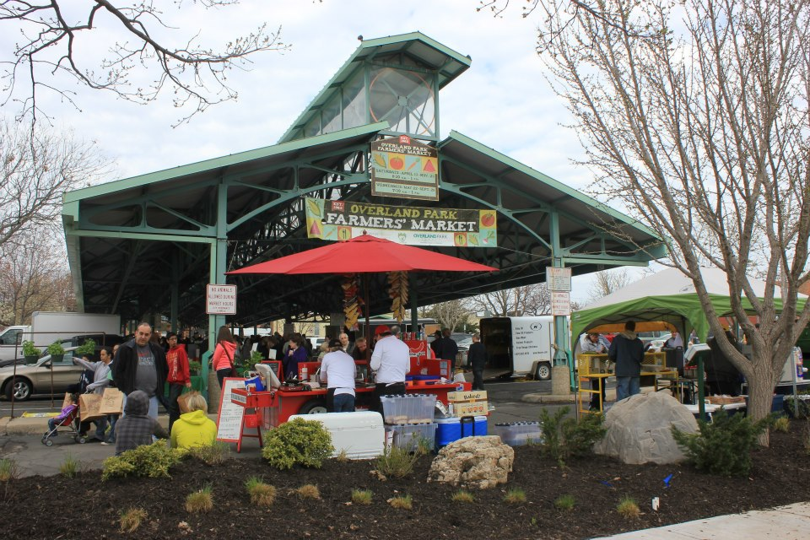
3 North Street – Community Pavilion- Farmers’ Market
Overland Park Farmers' Market
Overland Park, Kansas

Slide 44
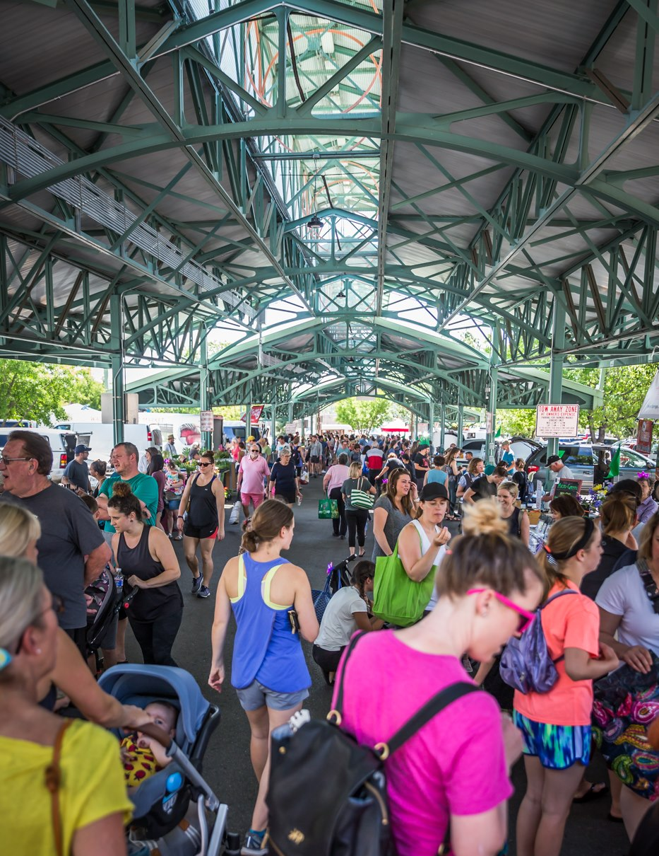
3 North Street – Community Pavilion- Farmers’ Market
Overland Park Farmers' Market
Overland Park, Kansas
Located in Downtown Overland Park, Kansas
Operated by City of Overland Park
Parks and Recreation Department
Open Air Concept (13,000 sq. ft.)
Farmers Market: Operates Wednesdays & Saturdays
Special Events
Live music during markets
Annually Fall Festival
Happy Hour Evening Markets

Slide 45
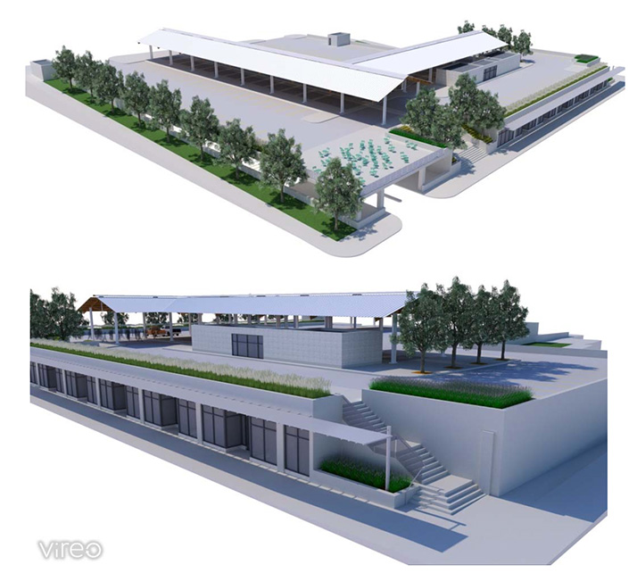
3 North Street – Community Pavilion- Farmers’ Market
Overland Park Farmers' Market
Overland Park, Kansas
New Market?
Need for a more contemporary market
Possible redevelopment or new location being considered
City has set aside $5 million to renovate/build
City staff assessing community needs for next 15+ years
Commercial kitchen, community events, private events, inclusive restrooms

Slide 46
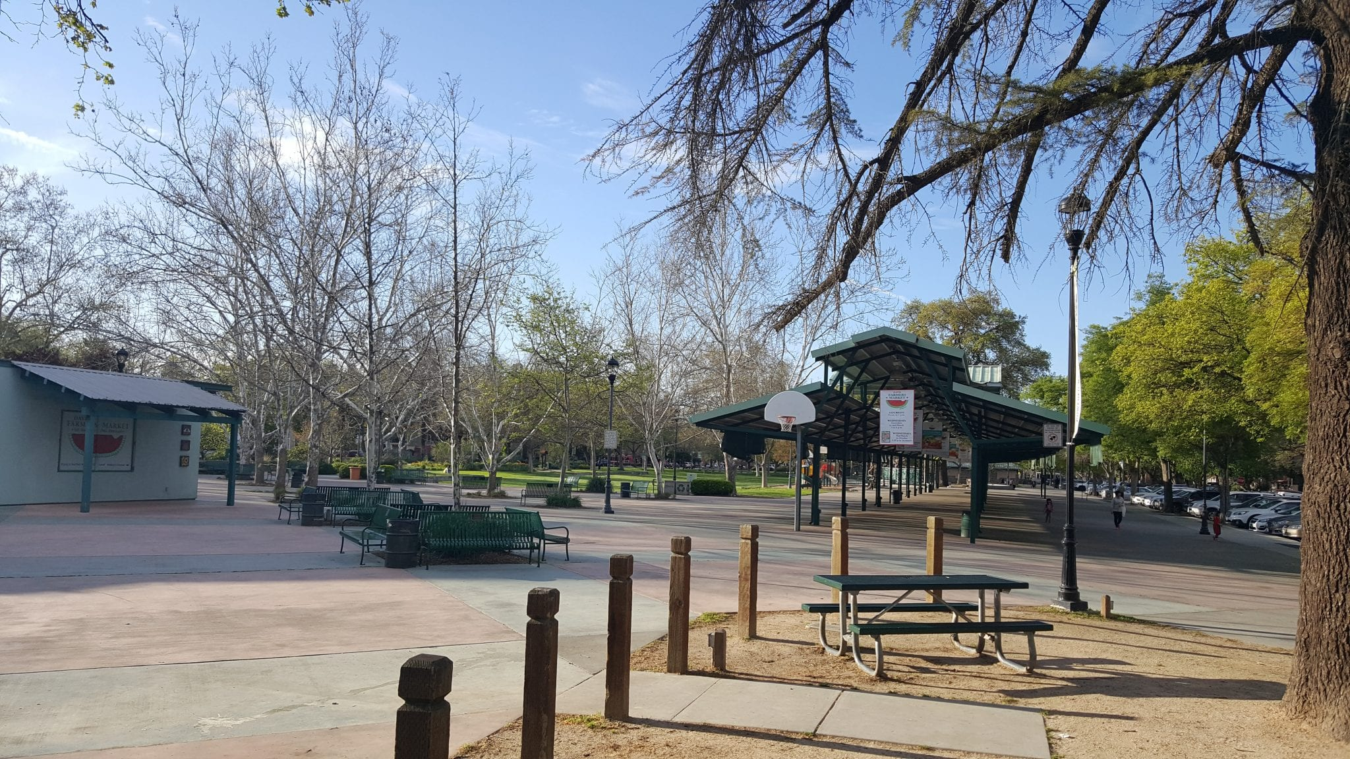
3 North Street – Community Pavilion- Farmers’ Market
Central Park Pavilion
Davis, California

Slide 47
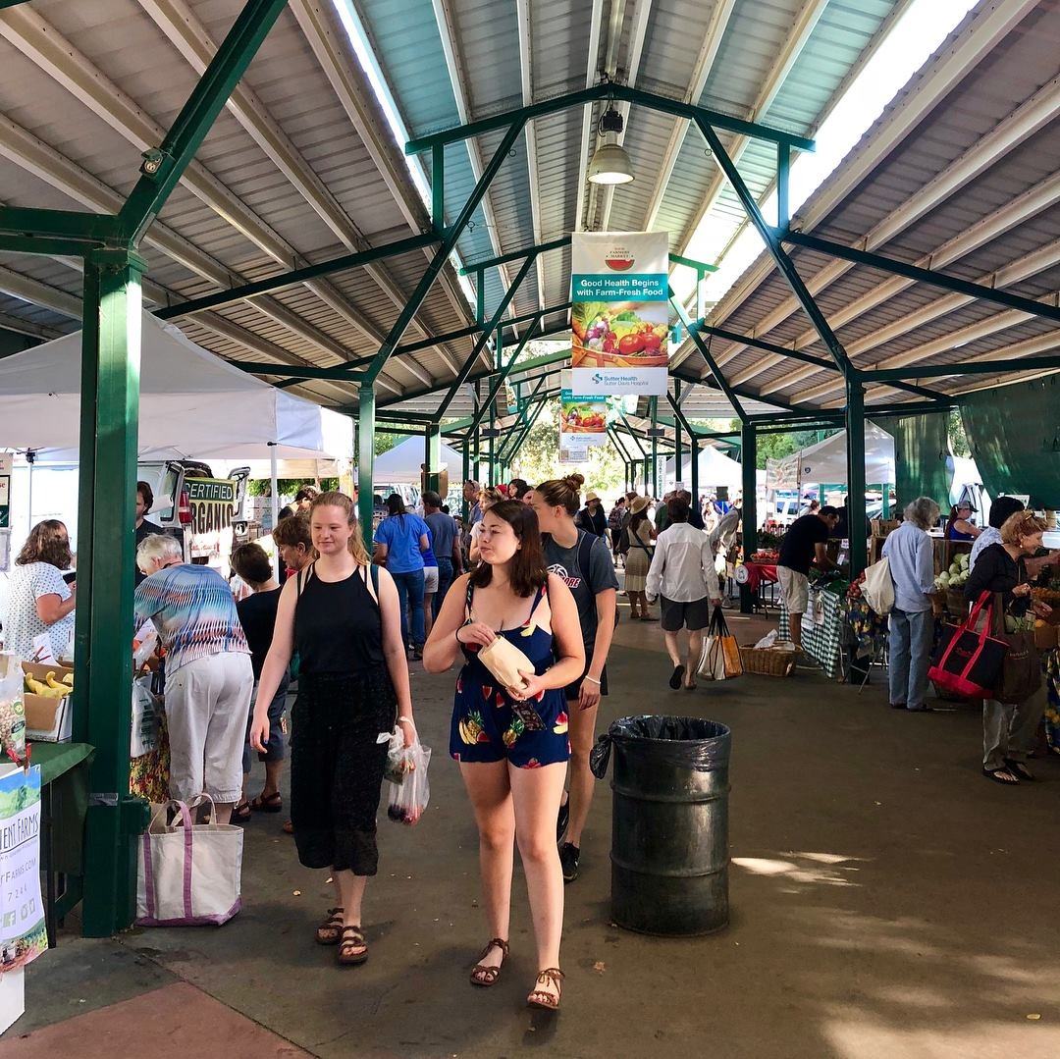
3 North Street – Community Pavilion- Farmers’ Market
Central Park Pavilion
Davis, California
Located in Downtown Davis
Owned by City of Davis
Farmers Market Operated by Davis Farmers
Open Air Concept (13,000 sq. ft.)
City permits roughly 30-35 events (not including Farmers Market days)
Picnic in the Park
Winter Market
Educational programs / Farm-to-School
Music in the Park
Pumpkin Patch
Holiday events
Winter Market
Weekly Craft & Vintage Fairs
Volvo Club event
UCD Marching Band events
Scouting events
Summer Camps

Slide 48
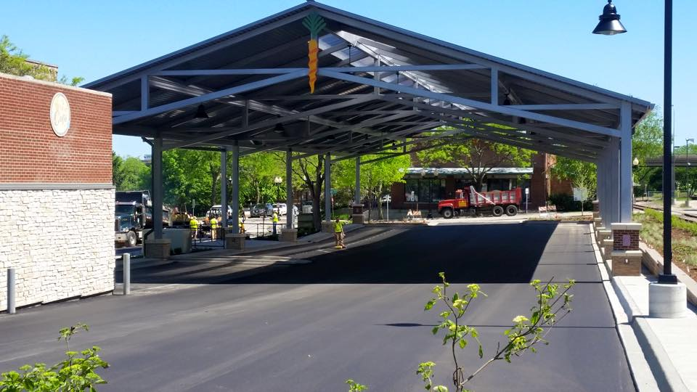
3 North Street – Community Pavilion- Farmers’ Market
City Market Pavilion
Rockford, Illinois

Slide 49
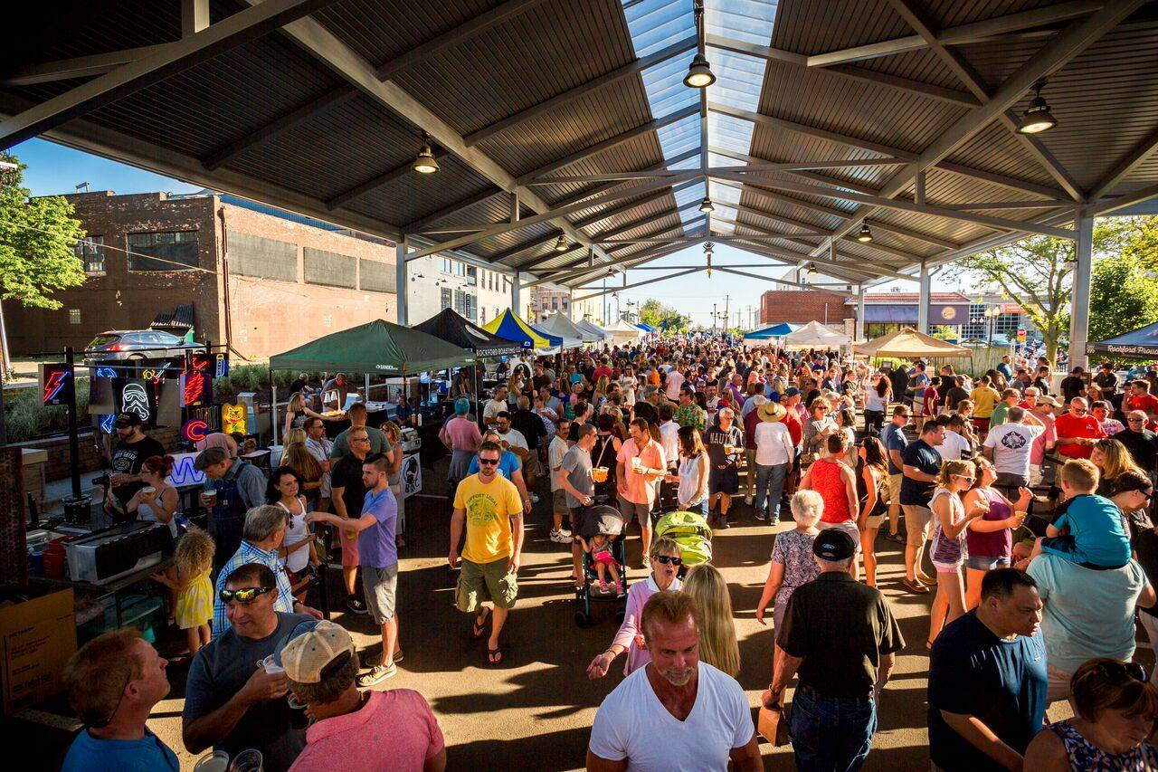
3 North Street – Community Pavilion- Farmers’ Market
City Market Pavilion
Rockford, Illinois
Located in Downtown Rockford
Owned by City of Rockford
Operated by Rock River Development Partnership
Oversees private rentals
Open Air Concept (18,360 sq. ft.)

Slide 50
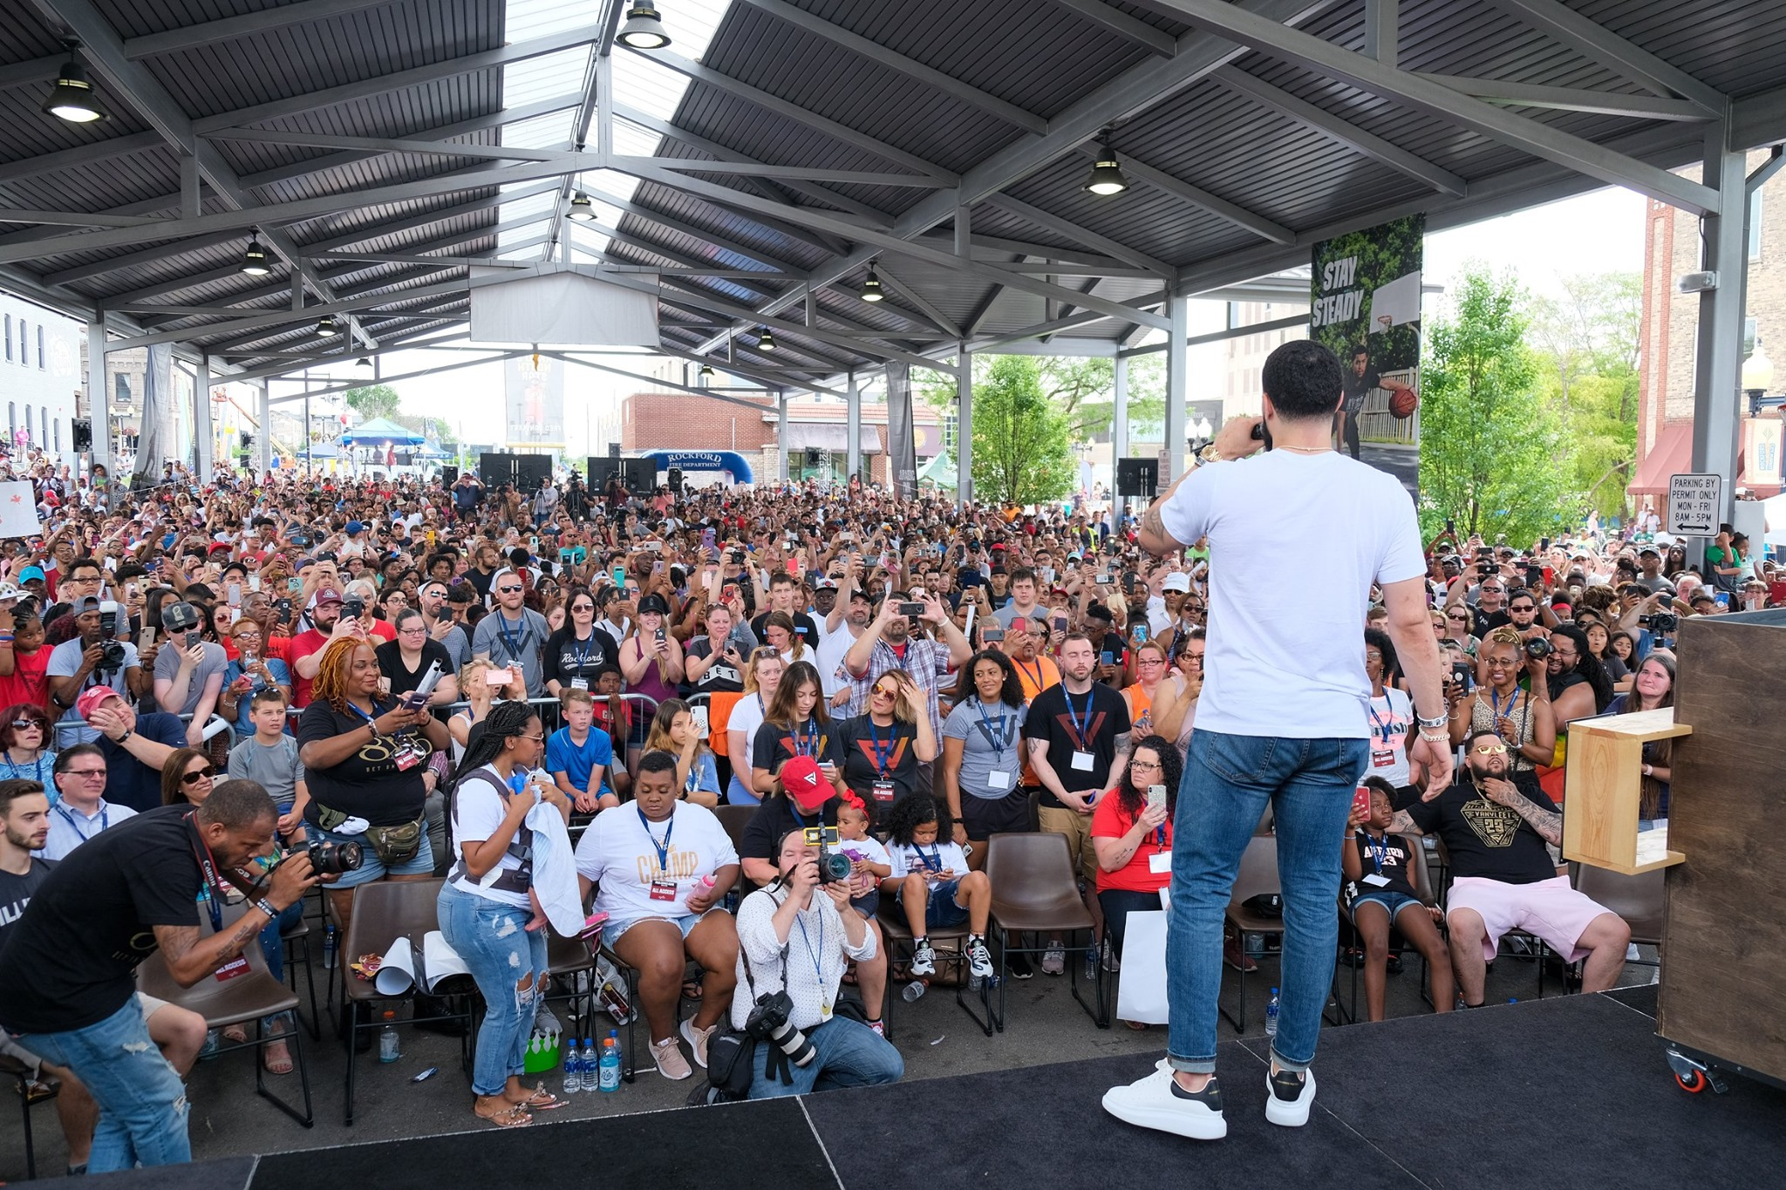
3 North Street – Community Pavilion- Farmers’ Market
City Market Pavilion
Rockford, Illinois
Special Events:
City of Rockford hosts 25 of their own events
Permitted events
Rockford City Market
Vintage Markets
Food Truck Festivals
Basketball Game Viewings
Holiday Markets & Events
Starting point for 5k races
Trivia Nights
Yoga
Private Events / Weddings
24/Hour Commercial Kitchen for rent
Used as parking lot when not used as an event space

Slide 51
3 North Street – Community Pavilion- Farmers’ Market
Operational Models
Discussed during the 2015-2017 planning process; no conclusions due to the uncertainty of the project
Following models provide potential framework for the operations
These models are for illustrative purposes to demonstrate what the operations could be, not what they would be
The community, the Parks and Recreation Commission, and the City Council would need to decide on what level of use and activity is acceptable for the site
If the project were to move forward, it’s possible that the operation could be a blend of the two models

Slide 52
3 North Street – Community Pavilion- Farmers’ Market
Operational Model: #1 – “Park Pavilion”:
More passive approach toward the operation
Farmers’ Market plus a limited number of events and activities
Mostly those that either the City produces or in partnership with local non-profits
Some that we permit to local non-profits like the Fitch Mountain Footrace.
Under this model the costs are less and the revenue potential would be more limited

Slide 53
3 North Street – Community Pavilion- Farmers’ Market
Operational Model: #1 – “Park Pavilion”:
Farmers’ Market
City-run Events
Movies in the Park
Sundays in the Plaza
Foss Creek Clean-up
Contracted Vendors: (Coffee Carts / Music)
1-2 New events
City-sponsored Events
Art After Dark
Jazz Village & Campus
Four Elements
Shakespeare in the Park
External / Permitted Events
Healdsburg Crush
Turkey Trot
Healdsburg Half Marathon
Arts & Antique Fair

Slide 54
3 North Street – Community Pavilion- Farmers’ Market
Operational Model: #2 – “Event Venue”:
Much more active approach toward the operation
Farmers’ Market plus significantly more events
External ticketed events (concerts, food events, more races and rides hosted at the site, etc.)
Non-ticketed external events (e.g. expos, fairs, etc.)
Corporate events
A limited number of weddings
Under this model the costs to operate the facility would be more, and revenue potential would also be greater

Slide 55
3 North Street – Community Pavilion- Farmers’ Market
Operational Models: #2 – “Event Venue”:
Farmers’ Market
All Activities from Park Pavilion model
Weddings (e.g. maximum of five/year)
Corporate Events
Banquets and Socials
Retreats
Large Meetings
Externally Sponsored - Ticketed
Concerts
Races and Rides
Food and Drink Festivals
External Non-Ticketed Event
Arts, Crafts, Antique Fairs
Fundraisers
Food & Drink Festivals

Slide 56
3 North Street – Community Pavilion- Farmers’ Market
Operating Budget Scenarios
Model | Expenditures (Costs) | Revenue (Income)
Park Pavilion | 161,000 | 16,117
Event Center | 316,000 | 202,367

Slide 57
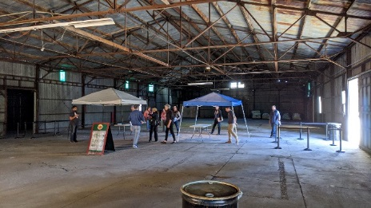
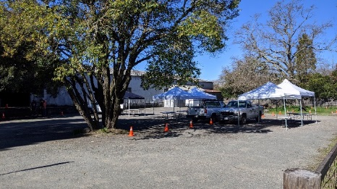
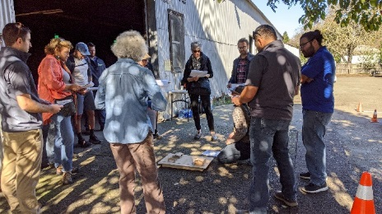
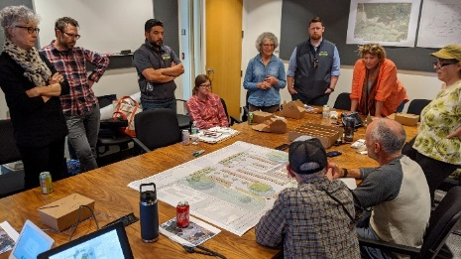
3 North Street – Community Pavilion- Farmers’ Market
Farmers’ Market Fit
Questions raised about whether the Market would fit on the proposed site
February 10, 2020: staff performed a “Fit Analysis” with representatives of the Market
Indoor and outdoor mock booths
Tabletop exercise

Slide 58
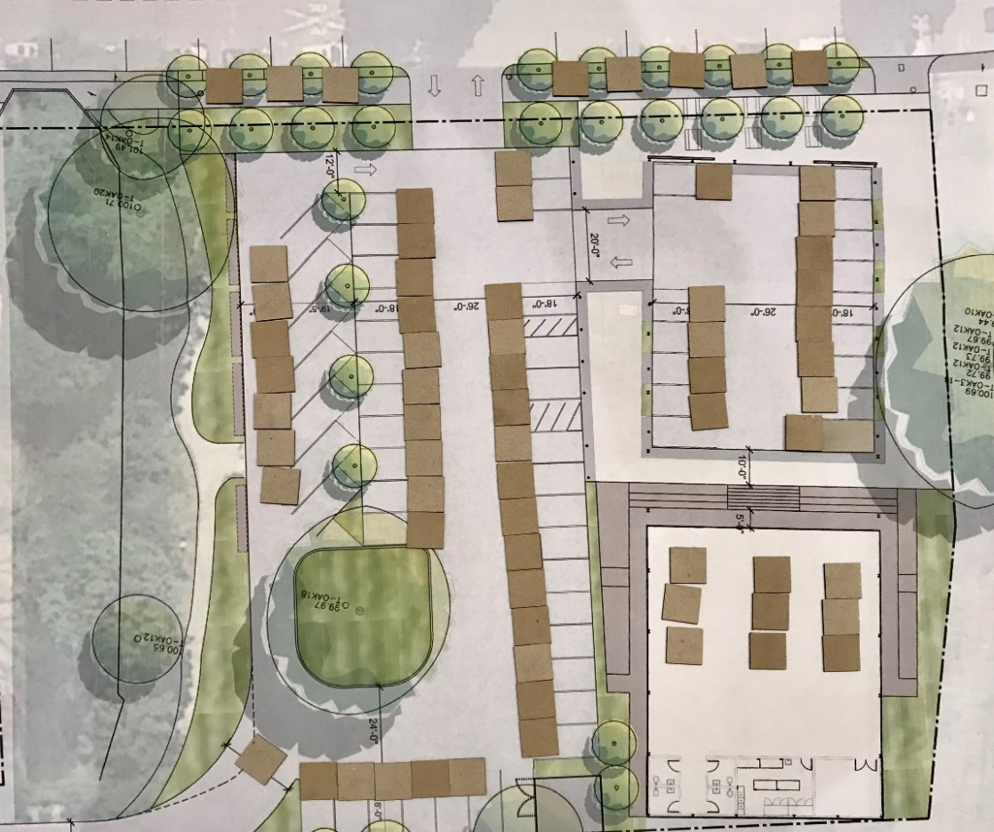
3 North Street – Community Pavilion- Farmers’ Market
Farmers’ Market Fit
Agreement from representatives of the Market that:
Current market could fit on the project site
Interest in using all portions of the site including the elevated section, which the market manager thought would be appealing to some market vendors
Demonstrated use of parallel parking on North Street adjacent to the project site for vendor parking, which would not require closing North Street
Room for some expansion of the market on the site; however, if the market were to grow significantly, there would be a need to pursue the North Street closure concept to accommodate additional vendors on an ongoing basis
Market requests that they continue to be closely involved in the design process to ensure the Market’s needs are met.

Slide 59
3 North Street – Community Pavilion- Farmers’ Market
Fundraising Efforts
July 2017: staff convened a workgroup of Commissioners, Friends of the Farmers’ Market, and community members
Shortly after, staff initiated a conversation with a local family about interest in a project in Healdsburg; discussion continued for several months

Slide 60
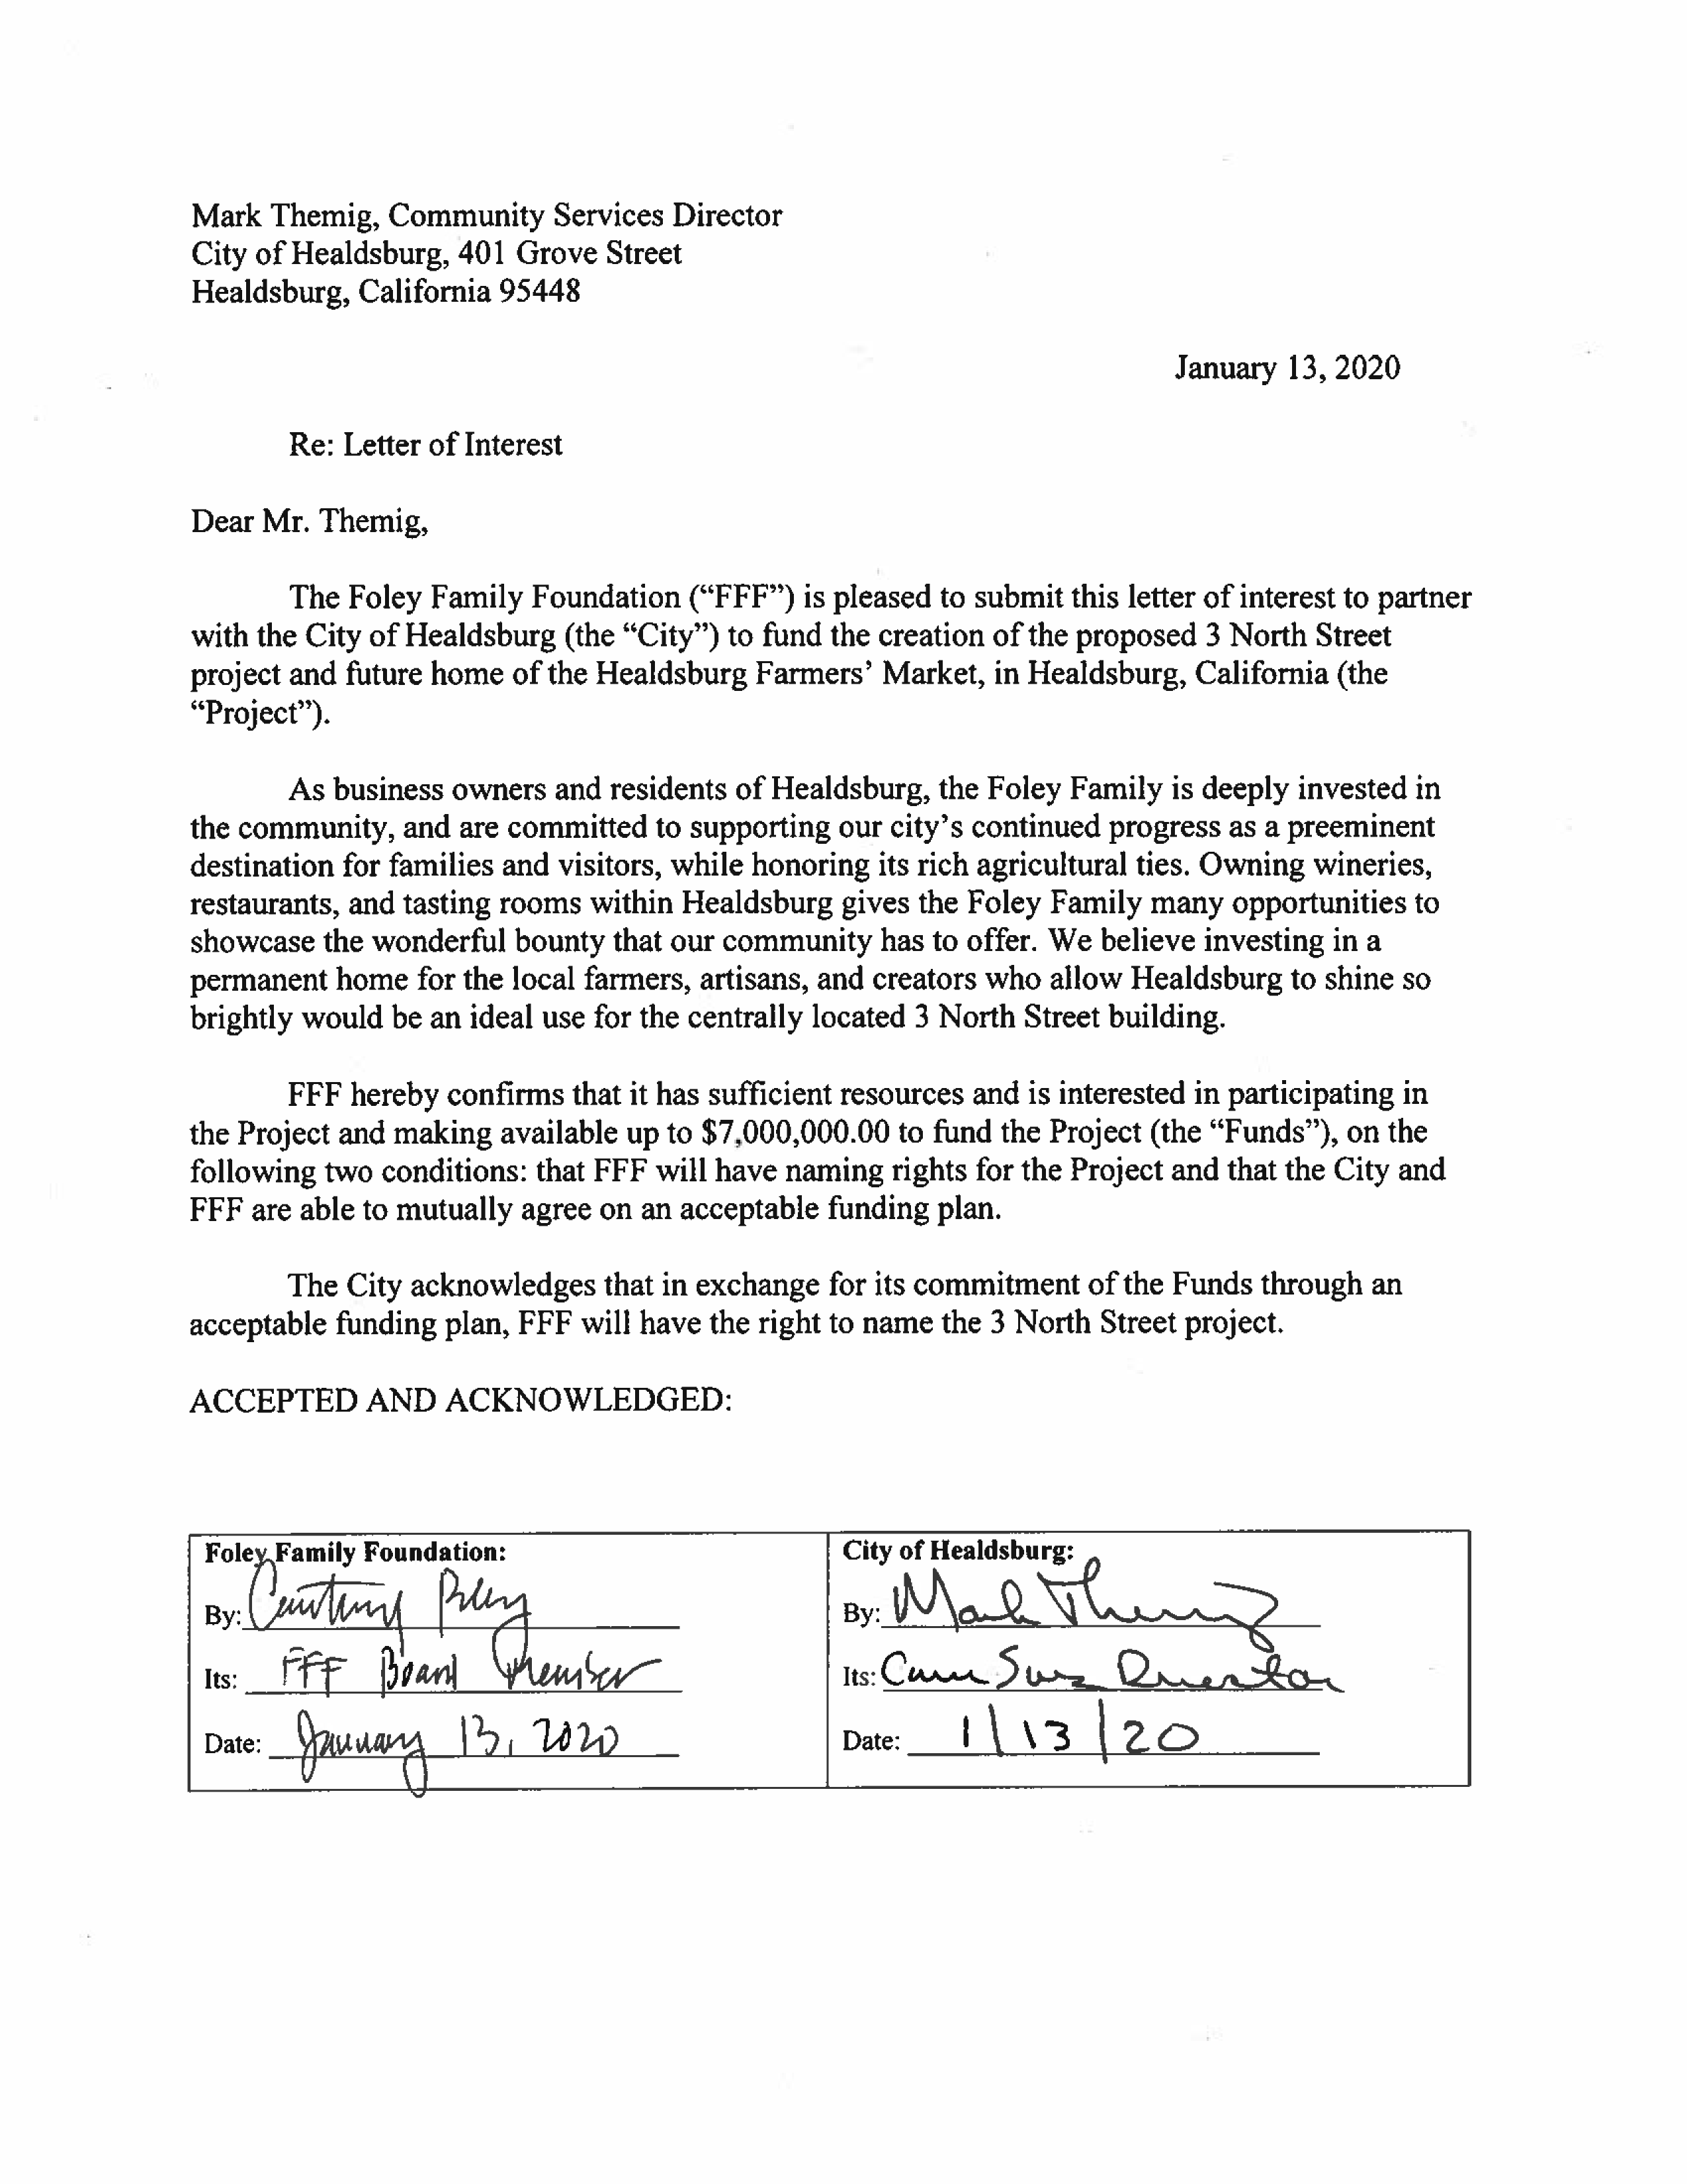
3 North Street – Community Pavilion- Farmers’ Market
Naming Partner Pledge
January 2020: City received a pledge from the Foley Family Foundation in an amount up to $7 million to fund the proposed 3 North Street-Farmers’ Market project as designed and approved by City Council
Pledge requires naming rights for the project and an agreement between the Foundation and the City
Pledge presented to City Council at a work session about affordable housing on January 21, 2020
Timeline: Funding agreement executed by April 15, 2020 that affirms the City’s support and general framework; additional details could be finalized after this date

Slide 61
3 North Street – Community Pavilion- Farmers’ Market
Parks and Recreation Commission Recommendation
February 12, 2020 the Parks and Recreation Commission considered the 3 North Street Project and the Foley Family Foundation pledge to fund the project and recommended approval
Motion carried 7-0

Slide 62
Summary
The previous sections of this report provided information related to the possible future use of the City-owned 3 North Street property, given options of a Community Pavilion-Farmers’ Market or an Affordable Housing project. Important considerations from the presentation are summarized below:
The site has a Downtown Commercial (DC) General Plan designation which would allow for a community facility like the contemplated Community Pavilion-Farmers’ Market as well as housing in association with a commercial use
General Plan policies that pertain to the property and its surrounding land-use areas include “Protect and enhance downtown and the plaza”; “Enhance the City’s waterways”; and, “Protect and enhance qualities that attract visitors to the City”

Slide 63
Summary Continued
The City of Healdsburg is anticipated to meet and exceed its State mandated Regional Housing Needs Allocation (RHNA) for the current cycle and the next cycle, without needing the 3 North Street site for housing production
SMART representatives have indicated there is sufficient space within the existing railroad right-of-way to accommodate a station platform adjacent to the 3 North Street site and the possibility of an optional station platform at the West Plaza parking lot
There may be the opportunity to coordinate with SMART to locate affordable housing on the SMART-controlled existing former train depot site
The previously approved schematic plan for a Community Pavilion-Farmers’ Market would fit typical farmers’ market needs and could serve a broad-range of community activities and events

Slide 64
Summary Continued
The approved Community Pavilion-Farmers’ Market schematic plan could be further refined as directed by the City Council to broaden the range of activities and events and duration of use during the year
Although a pledge in the amount of $7 million has been secured to construct the Community Pavilion-Farmers’ Market, additional funds would need to be identified to support on-going operations of the facility
Although the City-owned site and some additional affordable housing funds collected by the City could be offered by the City of Healdsburg towards realizing an affordable housing project on the 3 North Street site, an affordable housing developer would need to secure additional funds in addition to expected rental income to construct the project

Slide 65
Summary Continued
Moving forward with the development of the 3 North Street site in the near term would still allow the opportunity in the future to master plan the adjacent 4+/- acre West Plaza parking lot area
A West Plaza parking lot area master plan could consider and be informed by the following:
The Strategic Plan suggested Downtown Zoning and Density Study
SDAT’s master planning and housing recommendations
Work anticipated with the City’s next Housing Element update in 2022
SMART’s anticipated extension of rail service to the City of Healdsburg, which is not expected to occur until at least 2024, with the opportunity to finalize a location and design for a SMART rail station platform in the area. This master planning effort could require 18-24 months to complete.

Slide 66
Recommendation
Provide direction to staff on a preferred option to pursue for the future use of the 3 North Street site.

Slide 67
QUESTIONS!

