Slide 1

Healdsburg City Council Meeting
January 16, 2024

Slide 2

Fire Service Sales Tax Measure “H”
January 16, 2024
City of Healdsburg
*For informational/educational purposes only*

Slide 3

Fire Service Sales Tax Measure “H”
Title:
“Improved and Enhanced Local Fire Protection, Paramedic Services and Disaster Response Initiative”
Program Categories:
Wildfire prevention, preparedness, emergency response and vegetation management
Recruitment and retention of local firefighters
Updates to essential equipment and facilities

Slide 4
Background
Measure G - March 2020 ballot
  Was placed on the ballot by Sonoma County
  It had limited community outreach or education
  The measure failed passing the 66.67% threshold by 1.83%
Fire Service Working Group (FSWG)
  For Measure G, operated as technical specialist under the BOS Fire Ad-Hoc
  Now redesigned and operates as a subsection of the Sonoma County Fire Chiefs Association to fund the goal of improved and enhanced local fire protection, paramedic services and disaster response

Slide 5
measure “H”
FSWG started from square one on a new tax measure
  New strategy, new ordinance language
  New governance and allocation plan
Half-Cent General Sales Tax – March 2024 – Measure “H”
  Countywide benefit, filling service gaps
  Estimated to generate $60M-$65M annually directly to the fire service
  Focuses on adding personnel and new facilities or facility upgrades based on deployment analyses

Slide 6



New strategy
Petition driven initiative:
  Requires 50% +1 to pass
    Polls at 65%-67%
    Goal is to pass above 66.67% to negate threat of
    potential ‘roundtable’ measure
Changed FSWG Representation
Improved Union – Union relationship
Strong campaign managed by L-1401

Slide 7
NEW Ordinance
Managed by the Sonoma County Fire Chiefs Association
Change of allocation
Community Oversight Committee enhanced
Emphasis placed on adding local firefighters and building fire stations

Slide 8
New oversight
Independent Oversight Committee
  Independent County Residents – no active fire chiefs, fire directors, County employees, or spouses to any such individuals.
  Eleven (11) appointed members:
      Two (2) from Mayors’ and Councilmembers’ Association of Sonoma County
      Two (2) from a list submitted by the labor organizations responsible for collective bargaining
      Three (3) appointed by Sonoma County Fire Chiefs Association
        One (1) from the general public
      Two (2) appointed by the Sonoma County Fire Districts Association
        One (1) from the Sonoma County Taxpayers Association
  Three-year term with eligibility to reappoint

Slide 9
Annual Performance audit
Performance Audit
  Each agency shall prepare and distribute to the Committee an annual report which includes the amount received from the measure and how it was allocated.
    A summary of the positions and start up, equipment and facilities that were funded with revenue.
    The specific activities that support fire prevention, including vegetation management.
    Status of facility capital improvement projects that are funded with revenue from the tax.
    Demonstration of compliance with the requirements of this plan that the funds shall be used to pay for enhancing operations.
    Any remaining funds from allocations provided in previous years, and an explanation for proposed use of such funds.

Slide 10
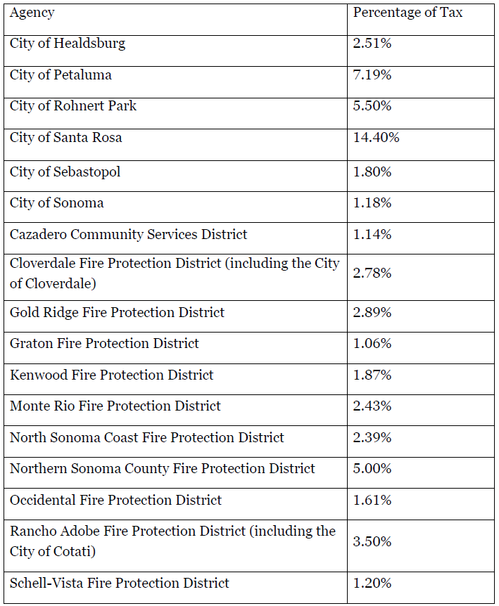
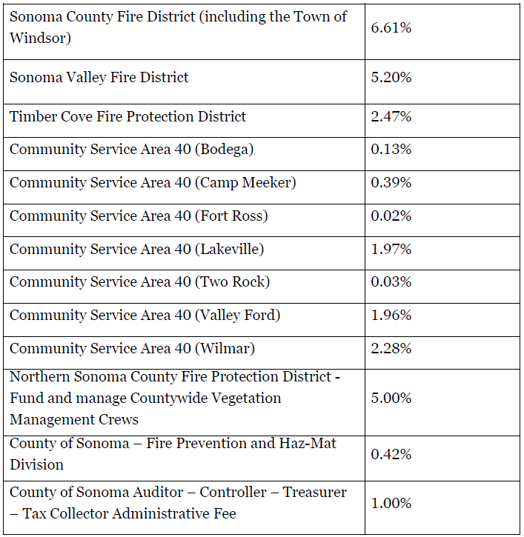
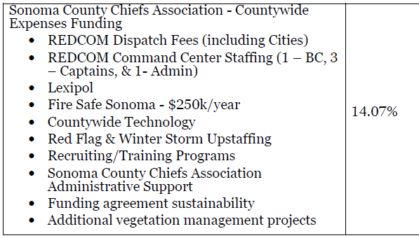
New allocation plan

Slide 11


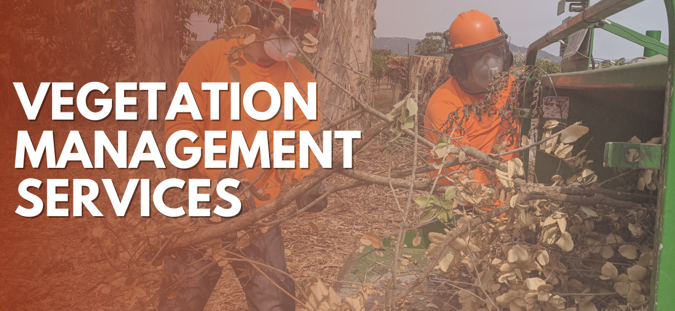
Partnerships and coordination
Unions
Vegetation management
  Firesafe Sonoma
  Farm Bureau
Outreach
  City Managers Association
  Mayors and Councils
  Taxpayer groups
  Board of Supervisors
  Civic groups and Business owners

Slide 12
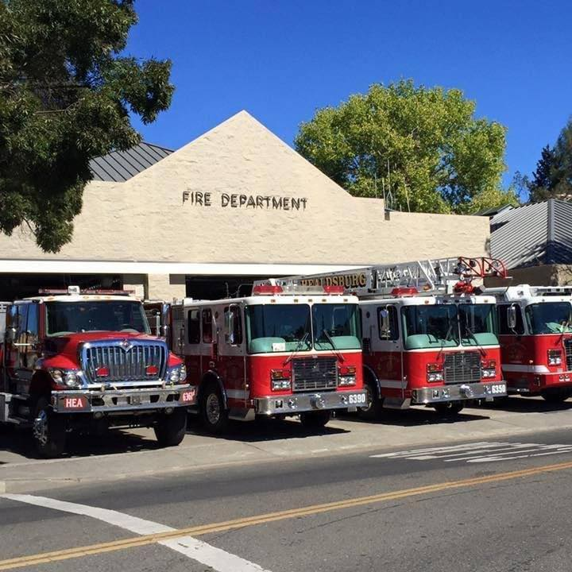
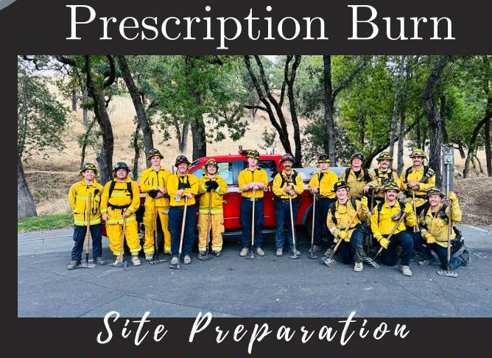
City of healdsburg specific impacts if Measure “H” passes
Direct to Healdsburg- over $1.5 Million
Facilities funding to support construction of the fire substation
Funding for a Fire Battalion Chief Position
Funding for a Fire Inspector Position
Funding for additional Firefighters and Fire Engineers
Indirect financial support:
  REDCOM Fees - $102,000/year
  Lexipol Fees - $3,000/year
  Upstaffing costs – red flag and winter storm
  Technology enhancements
  Training enhancements
  Vegetation Management projects

Slide 13
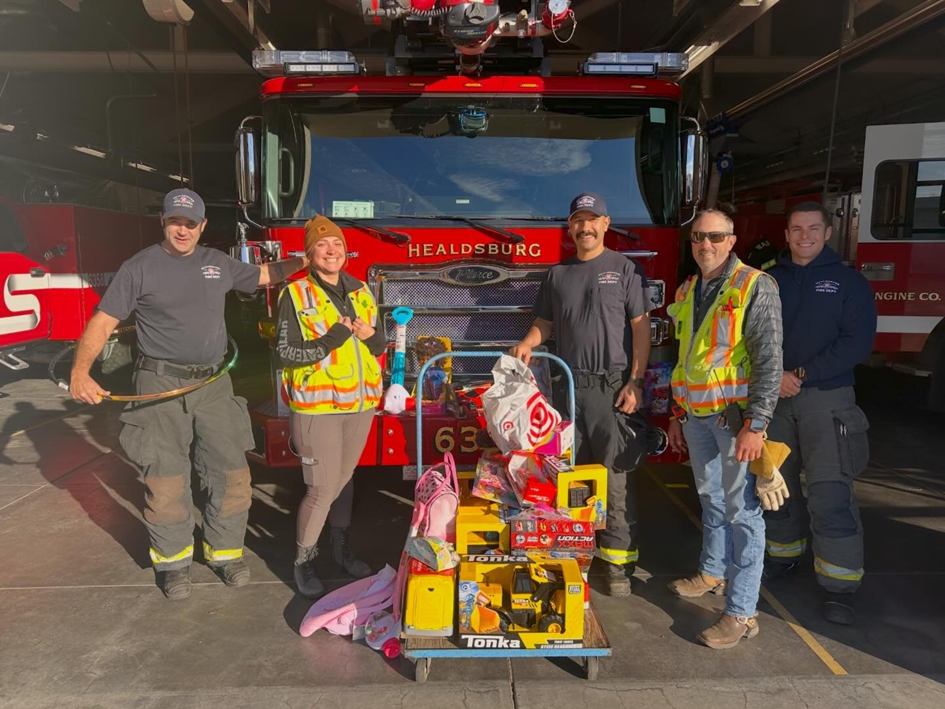
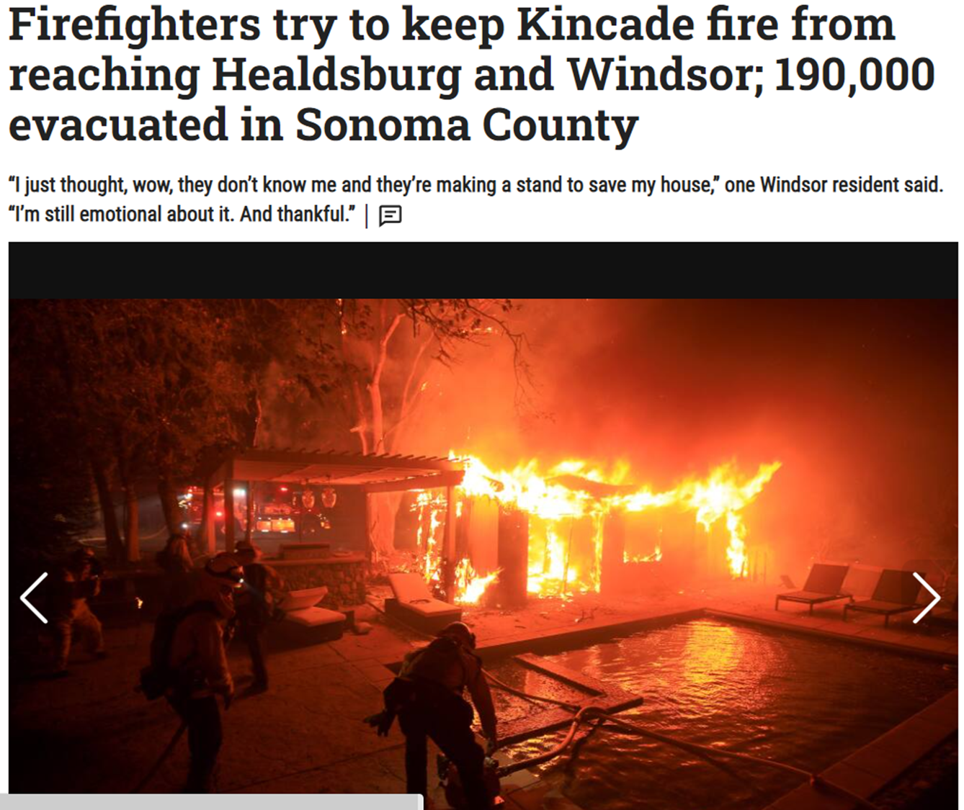
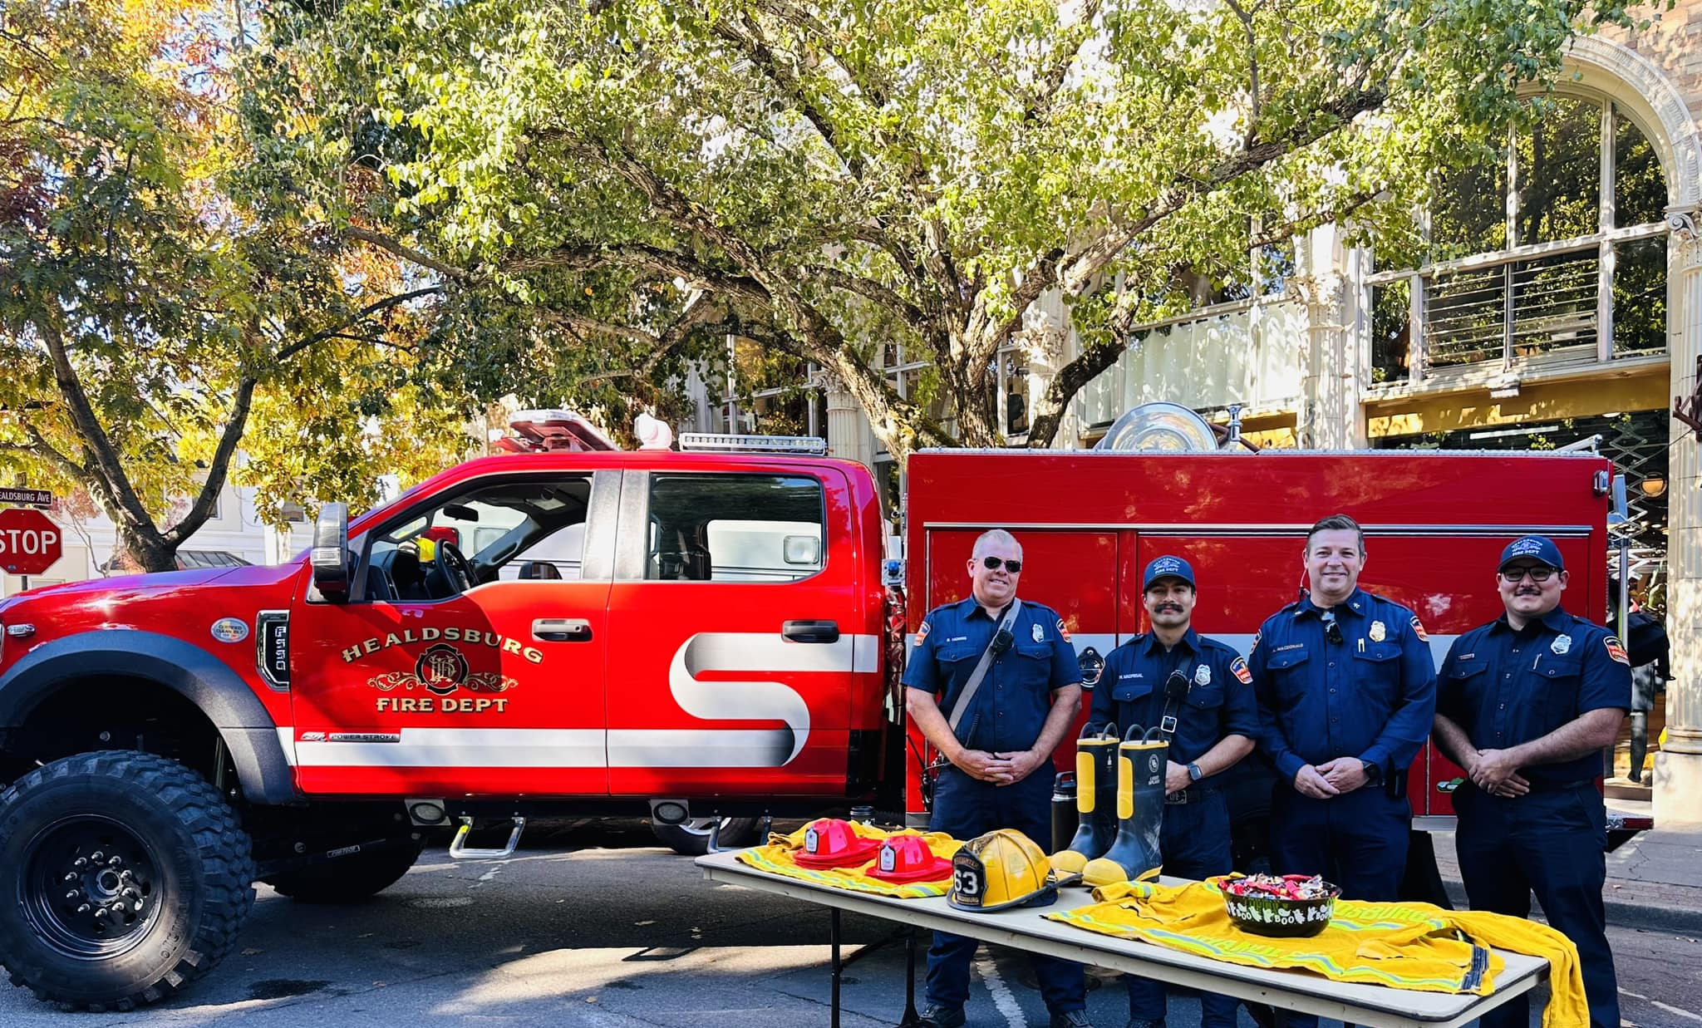
Questions?

Slide 14
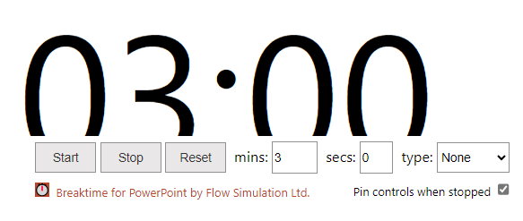
Public Comment
Comentarios del público

Slide 15
City Manager’s Report
City Council, January 16, 2024

Slide 16

Public Comment on Non Agenda Items
Comentarios del público sobre puntos no incluidos en la agenda de la reunión

Slide 17
Healdsburg Municipal Recycled Water Pipeline Project
Environmental Impact Report Amendment
A water resiliency project
Presented to the City Council
January 16, 2024

Slide 18
Recommended Council Action
Adopted a resolution of the City Council of the City of Healdsburg adopting an addendum to the final environmental impact report for the Healdsburg Wastewater Treatment Plant Upgrade Project (“Project”) and making recommended findings; and
Approve the Project as modified.

Slide 19
Background
The City has a Water Reclamation Facility (WRF) operates under an NPDES permit that allows discharge to the Russian River only from October 1 to May 14 - Discharge is prohibited May 15 to September 30
A 2018 feasibility investigation concluded that beneficial reuse for agricultural irrigation cost-effectively meets discharge prohibition
The investigation acknowledged that agricultural irrigation can be variable and diversification of the beneficial reuse program, including urban reuse, is a key for continued compliance and should be pursued as funding allows

Slide 20
Background
Staff applied for a number of grants based on recycled water pipeline concepts developed in 2005 with Water Reclamation Facility initial design
In 2023 the City was awarded $7 million under the DWR Urban Multi-benefit Drought Relief Grant program to bring recycled water into the City

Slide 21
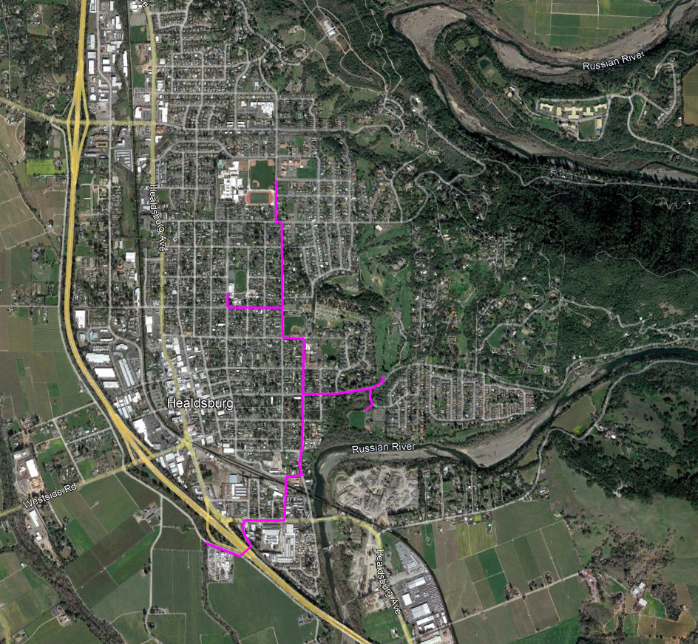
Original Municipal Recycled Water Concept
Community Center
Healdsburg Sr HS
Fitch Mtn School
Oak Mound Cemetery
Healdsburg Jr HS
Recreation Park
Concept developed with WRF design and EIR in 2005
Alignment study completed circa 2009
Plans prepared in 2011
Estimated Cost ~$10- to $13 million (2011 dollars)
8 locations served
Tayman Park
Healdsburg Elem Sch.
Badger Park
RW Fill Station on Kinley Drive

Slide 22
Municipal Recycled Water Concept Modified for Grant Budget
The Project as modified has alignment changes from the Project considered with the 2005 EIR.
  Crossing Hwy 101 is approx. 270 ft farther south
  Connection for Tayman Park and the cemetery is through roads in cemetery rather than extension on Matheson St.
  A bulk fill station is included on Healdsburg Avenue

Slide 23
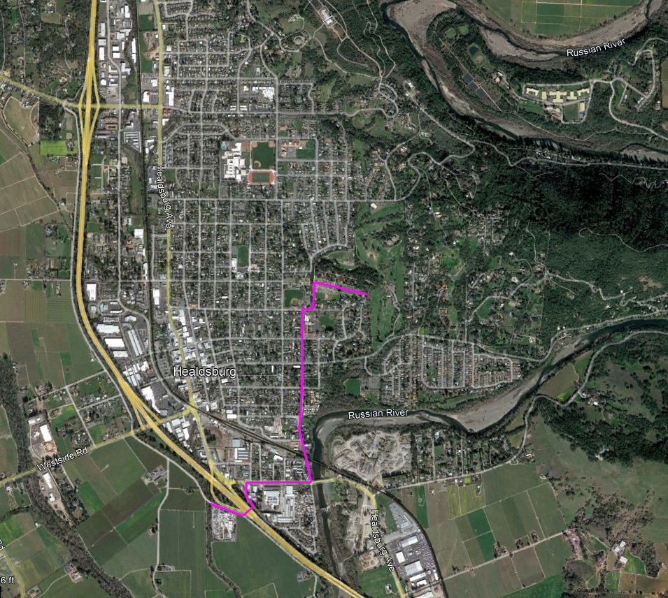
Municipal Recycled Water Concept Modified for Grant Budget
Community Center
Healdsburg Sr HS
Fitch Mtn School
Oak Mound Cemetery
Healdsburg Jr HS
Concept adjusted in 2022
Estimate cost $7 million
Includes 2.3 miles of pipeline and could serves 4 locations
Includes 1 fill station for residential / construction bulk hauling
About 20 months to construct
Recreation Park
Tayman Park
Healdsburg Elem Sch.
Badger Park
RW Fill Station on Kinley Drive

Slide 24
Anticipated Annual Recycled Water Use
Location | Acres | Original Concept | Grant Application | Award Adjusted Project
Community Center | 3.13 Ac | -- | 1.1 MG | --
Healdsburg Sr. HS | 7.8 Ac | 3.2 MG | 3.2 MG | --
Healdsburg Jr. HS | 3.7 Ac | 1.5 MG | 1.5 MG | --
Fitch Mtn School | 2.0 Ac | 0.8 MG | 0.8 MG | --
Healdsburg Elementary School | 3.0 Ac | 1.2 MG | 1.2 MG | 1.2 MG
Oak Mound Cemetery | 4.8 Ac | 1.9 MG | 1.9 MG | 1.9 MG
Tayman Park / GC | 57 Ac | 23 MG | 23 MG | 23 MG
Recreation Park | 2.8 Ac | 1.1 MG | 1.1 MG | 1.1 MG
Badger Park | 2.8 Ac | 1.1 MG | 1.1 MG | --
Total Potable Water Irrigation Replaced by Recycled Water |  | 33.8 MG | 35 MG | 27.2 MG
50% of application budget expected to net >75% of application benefits.

Slide 25
Potential for Changes in Environmental Impacts for the Municipal Recycled Water Pipeline
The municipal recycled water pipeline project concept was included in the environmental documents adopted in 2005.
With the passage of time and minor changes in alignment, the environmental impacts of the new project were evaluated to see if the mitigation and monitoring measures adequately reduced the impacts to less than significant levels.

Slide 26
Historical Environmental Analyses and Findings
The 2005 EIR concluded that the Project would not result in any significant, unavoidable environmental impacts, and included urban and agricultural uses
An addendum in 2014 expanded the recycled water service area for agricultural (vineyard and landscaping) deliveries to up to 25,000 Ac in a 100,000-Ac service area and to temporarily include hauled delivery.
An addendum in 2016 included a minor adjustment to the agricultural (vineyard and landscaping) delivery defined area to include 600 Ac south of the WRF, and extend the time for the hauled delivery method
A subsequent EIR in 2019 expanded the defined agricultural delivery area to include 1,160 Ac south of the WRF, add 3,450 Ac to the 100,000 Ac service area, expand agricultural uses to include agricultural uses in addition to vineyards (pastures and hayfields, orchards, cannabis, non-dairy livestock watering, frost protection, etc.), and make permanent the hauled delivery process
The 2005 EIR, 2014 and 2016 Addenda, and 2019 SEIR were certified by City Council to have with mitigation measures no significant impacts.

Slide 27
Need to Investigate if a New EIR is Appropriate on
Per CEQA Section 15162(b), a subsequent or supplemental EIR is required when:
  Substantial changes are proposed in the project or new significant environmental effects are found
  Substantial changes occur with the circumstances under which the project is undertaken, or
  New information of substantial importance shows the project will have significant impacts not discussed in the previous EIR

Slide 28
Need to Investigate if a New EIR is Appropriate
These potential triggers for a subsequent or supplemental EIR were reviewed by the design team, which found:
  Project Changes?: The Municipal Recycled Water Pipeline Project modification does not involve “substantial” changes to the Project and will not involve new significant environmental effects or a substantial increase in the severity of any previously identified environmental effects.
  Project Circumstances?: The Municipal Recycled Water Pipeline circumstances (e.g., wet year vs. drought year) may change year to year, but the impacts are not changed
  New information?: The pipeline will be constructed within the City’s right-of-way that is previously disturbed with little vegetation removal required. All relevant mitigation from the Certified EIR will be applied during implementation of the project modification.
The proposed modified Project could impact vineyard to avoid existing utilities not known in 2005. Some EIR modification is required.

Slide 29
Need for EIR Amendment
During design, the design team found that a possible temporary encroachment on agricultural land may be needed on Kinley Road if Caltrans encroachment cannot be secured. However, potential impacts can be mitigated to less than significant levels by amending a mitigation measure.
  Existing Mitigation Measure 3.1-3 indicates:
    “a. Construction activities shall be restricted to periods outside the growing season (i.e., growing and harvesting periods). Construction activities shall be undertaken in an expedient fashion, and associated construction staging areas shall be located outside of the agricultural fields. “
  Proposed Modification to Mitigation Measure
    “a. Construction activities shall be restricted to periods outside the growing season (i.e., growing and harvesting periods). Construction activities shall be undertaken in an expedient fashion, and associated construction staging areas shall be located outside of the agricultural fields. The City shall consult with landowners to appropriately compensate landowners for temporary losses in agricultural production resulting from project construction activities. “

Slide 30
Need for EIR Amendment
The proposed change to the mitigation measure would reduce impacts to encroached-upon agricultural land to less than significant levels.
The preparation of the EIR amendment took place while Caltrans permit was being reviewed.
  Caltrans is processing the permit
  The EIR amendment provides redundancy if needed during construction.

Slide 31
Recommended Council Action
Adopted a resolution of the City Council of the City of Healdsburg adopting an addendum to the final environmental impact report for the Healdsburg Wastewater Treatment Plant Upgrade Project (“Project”) and making recommended findings; and
Approve the Project as modified.

Slide 32
Questions

Slide 33

Public Comment
Comentarios del público

Slide 34
City Council 2023-24 Mid-Year Goal Update
City Council, January 16, 2024

Slide 35
Strategic Initiative 01: Economic Diversity and Sustainable Growth

Slide 36

Initiate Scoping of South Entry Area Plan
Goal
Identify key steps, timeline, and estimated cost. Conduct outreach to property owners. Include option to fund in the 2024 budget development process.
Status Update: ACTIVE
Draft scope of work and cost estimate completed. Met with property owners to discuss process and participation. Part of the plan area was recently listed for sale and outcome of the sale could impact timing and financing.
Applied for the designation of a Priority Development Area (PDA) that encompasses the ½-mile area surrounding the existing SMART rail depot site and the South Entry Area Plan area. Approval of the PDA will make the City eligible for planning grants.

Slide 37

Cannabis Business Program Implementation and Dispensary Application
Goal
Development and implementation of a cannabis business permitting program and completion of an application process for two cannabis dispensaries.
Status Update: ACTIVE
Two Cannabis Business licenses were awarded on November 13, 2023. Staff is currently work with the licensees to support business openings in the Spring/Summer of 2024.

Slide 38

Economic Diversity and Sustainable Growth
VMT
SB 743 requires jurisdictions to move away from Level of Service (LOS) to Vehicle Miles Travelled (VMT) in assessing circulation impacts in CEQA documents. City has received free technical support through MTC/ABAG to adopt VMT policy.
Status Update: COMPLETE
Policy adopted on October 2, 2023. The City will use the vehicle miles travelled (VMT) metric when assessing transportation related environmental impacts for discretionary projects instead of the traditional level of service (LOS) metric.
Annual Land Use Code Updates
Prepare amendments to the Land Use Code to address needed corrections, formalize interpretations, and streamline project review and approval.
Status Update: COMPLETE
Land Use Code Updates to revise and clarify sections related to large family daycares, amplified music, fence regulations, design review expiration, and conditional use permits were approved on June 20, 2023. Staff will continue to prepare amendments to the Land Use Code.

Slide 39

Electronic Plan Review
Goal
Working across departments responsible for development review to allow for electronic plan submittal and review.
Status Update: COMPLETE
Electronic plan submittal and review is now available and operational with all departments responsible for Plan Review, including Planning, Building, Public Works, Utilities, and Fire, participating in digital plan review.
In addition, the City received a grant to implement SolarAPP+ which will allow for web-based submittal and issuance of building permits for photovoltaic and battery storage systems.

Slide 40
Downtown Housing Development Capacity Study
Goal
Evaluation of existing codes, legislation, and law to identify barriers to, and opportunities for, increased housing capacity including options for a potential amendment of the Growth Management Ordinance on the November 2024 ballot.
Status Update: ACTIVE
The City Council approved a contract with Opticos Design to prepare the Downtown Housing Development Capacity Study on September 18, 2023. Staff held a kick-off meeting and tour of Downtown sites on October 16, 2023 and the work effort is currently underway.

Slide 41
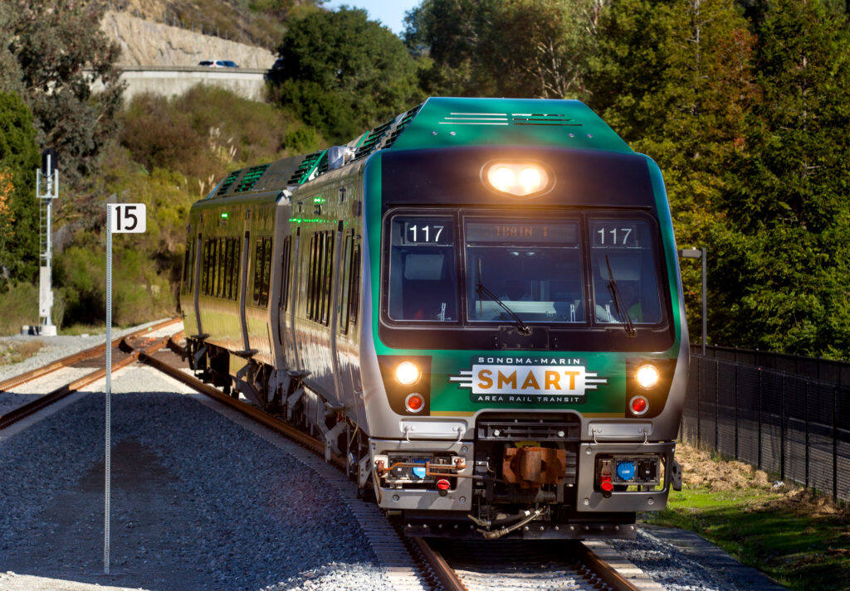
Economic Diversity and Sustainable Growth
SMART Station Planning
Determine preferred station location and explore land use and circulation opportunities presented by future rail service in Healdsburg.
Status Update: ACTIVE
A public meeting to receive feedback was held on October 19, 2023 at the Senior Center. Next Council discussion planned for February.
Retail Sales Tax Capture and Leakage Analysis
Provide report to City Council regarding sales tax categories and capture/leakage analysis
Status Update: ACTIVE.
The City has executed a contract to complete the retail sales tax leakage analysis. Staff anticipates a presentation to Council in the next two months.

Slide 42
Housing Element Implementation Land Use Code Updates
Goal
With adoption of the Housing Element the City will need to pursue several Land Use Code updates to address programs related to changes in State Law including Density Bonus Ordinance, Objective Design Standards, SB9, and more.
Status Update: NOT YET STARTED.
Staff intends to formally initiate this work upon completion of the housing needs analysis and housing capacity study.

Slide 43
Strategic Initiative 02: Environmental Stewardship

Slide 44

Environmental Stewardship
Climate Mobilization Strategy
Development of a community climate mobilization strategy.
Status Update: COMPLETE.
Council adopted the Climate Mobilization Strategy (CMS) on October 16, 2023. The implementation and management of the plan will be a new ongoing task.
Postal Fleet Electrification White Paper
Outline information, utility infrastructure and potential costs needed to electrify the local USPS fleet. Federal government is exploring locations for electrification.
Status Update: ACTIVE
The postal fleet electrification white paper was incorporated into the CMS as measure TE-5.1. This paper will be used to inform the study and the Electric Department’s requirements to support building and transportation electrification (CMS measure BE-1.1).

Slide 45
Strategic Initiative 03:Affordable Housing

Slide 46

6th Cycle Housing Element Update
Goal
Complete and Adopt Housing Element.
Status update: COMPLETE
The 6th Cycle Housing Element Update was adopted by the City Council on May 1, 2023 and certified by the California Department of Housing and Community Development (HCD) on June 29, 2023. Plan implementation and management will be the new ongoing task.

Slide 47
Housing Element Work Group
Goal
Convene the HEWG to make recommendations and study housing issues in Healdsburg as directed by the City Council.
Status Update: ACTIVE
Pursuant to the City Council's decision on September 18, 2023, the Housing Element Work Group (HEWG) has been reorganized to implement the housing initiatives detailed in Resolution No. 171-2022. The first session of the reconstituted HEWG was held in December.

Slide 48
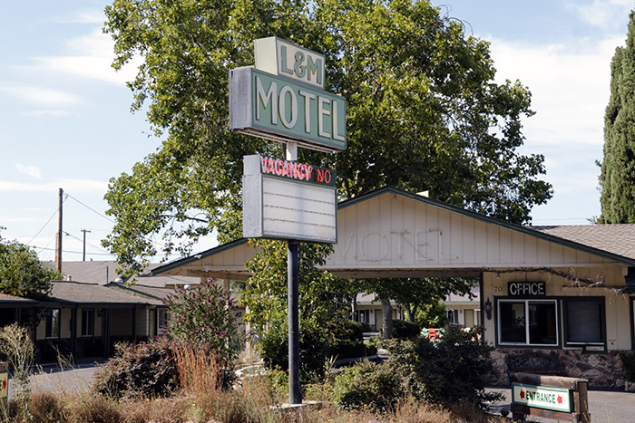
L&M Village
Goal
Operate the L&M Village Interim Housing Program and secure additional funding for operations. Initiate process of quarterly updates to City Council and regular outreach to neighbors and stakeholders.
Status Update: ACTIVE
The Housing Department provides the City Council with quarterly updates on the L&M Village Operations and annual reports to the State HCD. Both Housing and Reach for Home staff are actively engaging with the concerns of neighboring residents. Secured $341,000 in CDBG funding for capital improvements and services.

Slide 49
Strategic Initiative 03:Affordable Housing
Scattered Site Project
Complete the renovations and lease-up of the scattered site housing units at 1302 Prentice, 500 Piper and 531-535 University.
Status Update: ACTIVE
Renovation projects at 500 Piper and 531-535 University have been completed by Burbank Housing, and occupancy by tenants has been established. Prentice is advancing towards completion prior to the end of the current fiscal year.
Saggio Hills Affordable Housing
Complete the DA and DDA for the Saggio Hills Affordable Housing project and apply for State funding for the development of the units.
Status Update: ACTIVE.
The City has executed a Disposition and Development Agreement with Freebird Development for the 110 -unit Saggio Hills project. Freebird is pursuing financing through the Multifamily Housing Program via State HCD and assessing additional funding avenues.

Slide 50
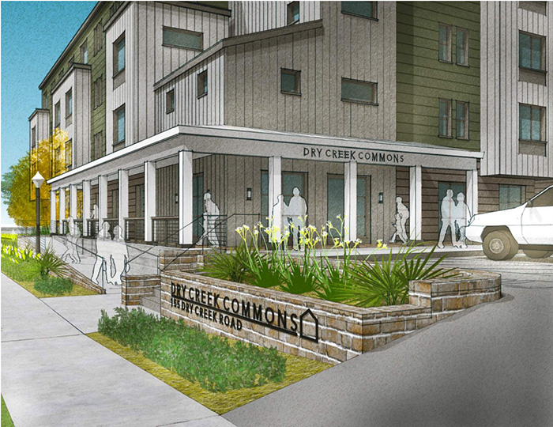
155 Dry Creek Affordable Housing
Goal
Support Burbank Housing in applying for State funding for the development of the Dry Creek Commons.
Status Update: ACTIVE.
Executed a Disposition and Development Agreement with Burbank Housing for the 58-unit project located at 155 Dry Creek Road. Burbank procured $1.7 million in federal grants and submitted an application for $9 million through the Joe Serna Jr. Farmworker Housing Grant Program. Next phase involves applying for Low-Income Housing Tax Credits.

Slide 51
Welcome Packet Outlining Tenants & Landlord Rights
Goal
Develop a welcome packet to be provided to all new residents that includes information on city services, support programs, and tenant and landlord rights.
Status Update: ACTIVE.
The development of the Welcome packet is in process and it is anticipated it will be completed this fiscal year.

Slide 52
Strategic Initiative 04: Infrastructure and Facilities

Slide 53
Strategic Initiative 04: Infrastructure and Facilities
Library Upgrades
City is pursuing a grant with Healdsburg Library to support facility modernization effort and developing a lease for the facility.
Status Update: ACTIVE.
While the grant was unsuccessful, the library and City are still collaborating on upgrades to the Library facility. The Council approved the City entering into a new lease with the library on October 16, 2023 and the library is planning a renovation project to start later this year.
New Fire Substation
Build new fire substation.
Status Update: ACTIVE.
The groundbreaking ceremony was held on October 11, 2023 and construction on the substation is progressing.

Slide 54
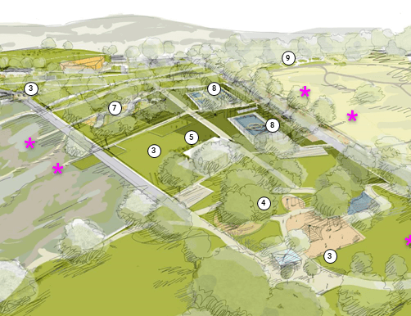
PARKS
Parks Financing Plan
Continue to develop and implement a plan to finance a new park on the north end of town and redevelopment of Badger Park
Status Update: ACTIVE.
Staff anticipates bringing an update on the park financing plan to Council on February 20, 2024. Work is anticipated to continue on bond issuance through FY24-25. CEQA has been completed for Montage and is currently underway for Badger.

Slide 55
STREETS / BIKES / PEDESTRIAN INFRASTRUCTURE
Healdsburg Avenue Complete Street Project
Prepare design and complete utility work in advance.
Status Update: ACTIVE.
The designer for the Healdsburg Avenue Complete Streets project has been selected and we have received approval to proceed from Caltrans. Design work is underway.
Grove Street Neighborhood Plan
Pedestrian, bike, and drainage improvements.
Status Update: ACTIVE.
A designer has been selected for this project and design work is underway.

Slide 56
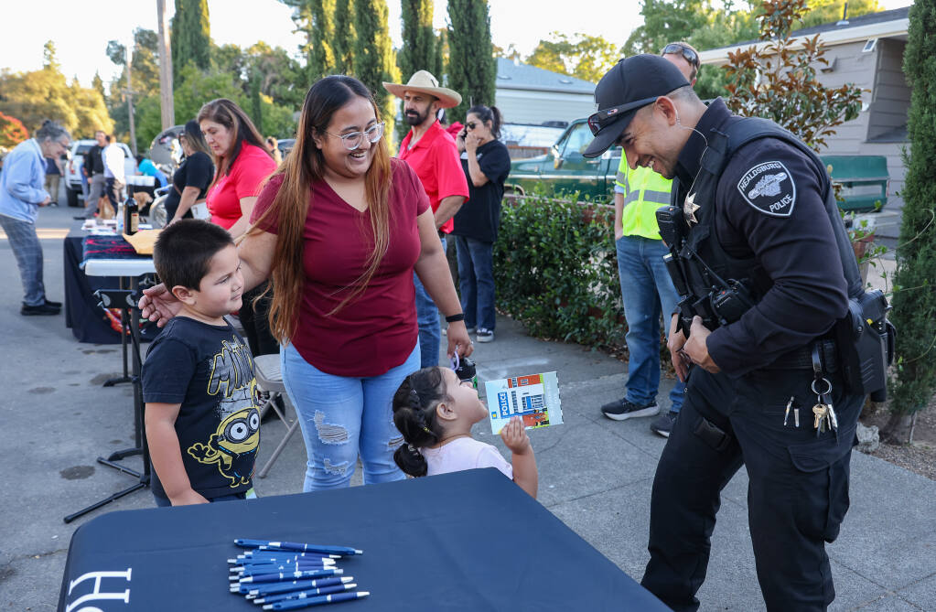
STREETS / BIKES / PEDESTRIAN INFRASTRUCTURE
Ward Street Neighborhood Plan
Infrastructure improvements to improve ped and bike mobility, lighting, and safety.
Status Update: ACTIVE.
Completed short-term improvements on Ward Street, including increased lighting and the addition of a speed bump. In partnership with Corazon, Council and staff participated in an outreach event. Staff also completed a survey of the residents.
Enhanced Maintenance for LIDs
Improve maintenance and appearance of Low Impact Development landscaping areas in downtown area.
Status Update: ACTIVE.
Public Works staff have compiled a list of private and public LID features to ensure all are maintained.
A new maintenance contract was executed in September for repair and maintenance (including cleaning) of public LID features including trimming of trees.

Slide 57
WATER
INFRASTRUCTURE
Municipal Recycled Water Pipeline
Recycled water for irrigation. Will provide recycled water to several City parks, athletic fields, public golf course and cemetery to make more drinking water available to residents and businesses (offsets).
Status Update: ACTIVE.
The construction documents are 90% complete. CEQA addendum to tonight. Bid opening anticipated for March.
Aquifer Storage and Recovery (ASR) Wells
Focus to improve water supply to supplement Healdsburg water supply during times of drought and low flows in the Russian River.
Status Update: ON HOLD.
Passed initial CalOES review phase and grant application is now with Federal administrators. Progress on the project has been stalled while we wait on final response from BRIC Grant and the approval to move into design and construction.

Slide 58
WATER
INFRASTRUCTURE
Fitch Well Field & Dry Creek Well Field
Investment for regulatory drinking water filtration improvements. State board has increased the regulatory obligations for the Fitch (Badger) and Dry Creek well fields.
Status Update: ACTIVE.
Design work has been completed and under review by the State Division of Drinking Water. Staff is seeking grant funding to support the work. Funding consideration will be included in the updated water and wastewater cost of service study. Funding and design now needs to consider the increased costs of PFAS filtration.

Slide 59
Strategic Initiative 05: Effective Governance

Slide 60
Effective Governance
Diversity, Equity, and Inclusion Plan
Development of a community wide diversity, equity, and inclusion plan.
Status Update: COMPLETE.
The City Council accepted the DEI Plan on August 7, 2023. On October 23, 2023, Council held a workshop to discuss implementation and next steps. Implementation work is ongoing.
Business License Process Modernization
Configure and launch an online platform where businesses can obtain a license conveniently and efficiently.
Status Update: COMPLETE.
Business License renewals for FY 23-24 were successfully completed in the new System.

Slide 61
Effective Governance
Electric Utility Rate Study
Update rate structure to reflect current and projected costs, planned infrastructure improvements, and desired climate initiatives.
Status Update: COMPLETE.
The City Council adopted a new rate structure on June 5, 2023. The new electric rates went into effect November 1, 2023.

Slide 62
Strategic Initiative 06: Public Health and Safety

Slide 63
Implement Community Wildfire Protection Plan
Goal:
Explore and pursue potential grant opportunities to establish a Wildfire Mitigation Assessment program and fund a Large Arundo Removal project within the Russian River Watershed.
Status Update: ACTIVE.
Supported a grant application with Russian River Keeper (RRK), resulting in the successful acquisition of grant funding for Arundo removal from just west of Memorial Bridge around Fitch Mountain. Partnered with RRK to identify key treatment areas for the greatest impact on fire safety. Arundo removal project underway since August 2023 and HFD continues to help facilitate work.

Slide 64
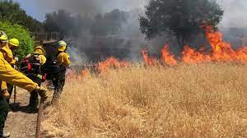
Fire Fuels Reduction
Goal:
Maintain Coastal Conservancy grant by continuing fuel reduction work. In addition to Mechanical Mastication, Hand Crews, Grazing and Prescriptive Burns we are also working to incorporate tribal burns into our wildfire prevention strategy.
Status Update: ACTIVE.
Successfully treated the Fitch Mountain Open Space Preserve, Healdsburg Ridge Open Space Preserve, and various infrastructure locations within the City, including the Gauntlett Reservoir. The treatments implemented included grazing by sheep and goats, prescription pile and broadcast burns, mechanical mastication, and the utilization of hand crews.

Slide 65
Emergency Preparation
Goal:
Ensure/Maintain a strong level of Emergency Preparedness, through enhanced staff trainings, technology implementation, and community outreach. Complete update to Local Hazard Mitigation Plan (LMHP)
Status Update: ONGOING.
WebEOC is fully implemented and EOC technology improvements are nearing completion. The Evacuation zones for the City have been updated. The draft Local Hazard Mitigation Plan has been reviewed by CalOES and staff is working on responding to comments.

Slide 66
Strategic Initiative 07: Community Services

Slide 67
POLICIES AND PROGRAMS
Arts and Culture Master Plan Implementation
Work collaboratively with the Creative Leadership Team and the community to complete components of the first phase of the master plan implementation presented to City Council on 9/19/22.
Status Update: ACTIVE.
First round of the grant program is complete and awardees are working on their projects. Staff just announced the application period for the second round of grant funding. Staff working on the first draft of a Percent for the Arts Ordinance.

Slide 68
POLICIES AND PROGRAMS
Commission Composition
Provide analysis of redefining or combining the Parks and Recreation and Senior Citizens commissions for City Council consideration.
Status Update: COMPLETE.
Council formed a subcommittee to meet and discuss Senior Commission and the full Council agreed to keep commissions as currently setup.
City-HUSD Joint Use Agreement
Work with HUSD to review and update the Joint Use Agreement for operation and maintenance of shared facilities.
Status Update: NOT YET STARTED.
HUSD and City staff will begin meeting in Q2 2024 to review and discuss the current Agreement and consider updates to incorporate new facilities, maintenance protocols, and facility scheduling.

Slide 69
POLICIES AND PROGRAMS
Deferred Maintenance and Improvement Plan
Develop a deferred maintenance program and begin implementation.
Status Update: ACTIVE.
The City Council approved moving forward with the Deferred Maintenance Plan for Fiscal Year 2023-24.
Healdsburg Avenue Bridge Permanent Lighting Display and Policy
Obtain cost estimate for installation of a permanent lighting system and develop lighting policy for City Council to address short- and long-term practices for determining when to light the bridge.
Status Update: COMPLETE.
The Bridge Lighting Policy was approved at the October 2022 City Council meeting. In October 2023, staff procured cost estimate for installation of permanent lighting system and the plan was presented to Council. Plan is to stay with interim lighting for the time being.

Slide 70
POLICIES AND PROGRAMS
Master Calendar & Cost Analysis for Special Events
Create a master calendar for special events and provide costs analysis and cost sharing summary.
Status Update: COMPLETE.
Council adopted the master events calendar in December 2023.

Slide 71

COMMUNITY FACILITIES
Foley Family Community Pavilion
Complete CEQA, Design Review, construction drawings, bidding, and majority of construction.
Status Update: ACTIVE.
The City Council approved the construction contract in December of 2023. The groundbreaking event will be scheduled in the coming weeks.
Senior Center Accessibility Construction Project
Replacing Doors and improving accessibility at Senior Center from and rear doors.
Status Update: COMPLETE.
This project was completed in June of 2023.

Slide 72
COMMUNITY FACILITIES
Villa Chanticleer Capital Replacement Plan
The agreement with Milestone Events Group requires the City and Milestone to work collaboratively to develop a long-term capital replacement plan for the Villa.
Status Update: ACTIVE.
Milestone and City staff will develop the plan in 2024 to be considered as part of the FY24-26 budget process.
Concept Plan for West Plaza Parking Lot
Develop concept options and costing for maintenance upgrades and beautification of this parking lot.
Status Update: ACTIVE.
Staff are currently scoping and developing a budget for the project. Staff will present potential options during the budget process.

Slide 73
PARKS AND OPEN SPACE
Saggio Hills Park Development
Complete CEQA master plan review, design development, construction drawings, bidding, and initial construction.
Status Update: ACTIVE.
CEQA has been completed for Montage. The consultant is putting together a design team for design development.
Saggio Hills Park Naming Process
Complete a community-based process to identify potential names for the new park for City Council consideration.
Status Update: ACTIVE.
32 applications potential names submitted as potential names for the new park. The park naming subcommittee members will meet to review and reduce the number of applications and work to fact-check the information and present to PRC followed by Council.

Slide 74
PARKS AND OPEN SPACE
Badger Park Redevelopment
Complete CEQA master plan review, design development and construction drawings. Bidding contingent on timing of prior work.
Status Update: ACTIVE.
The CEQA process underway.
Fitch Mountain Access Improvement Project
Complete construction drawings, bidding, and construction for project.
Status Update: ACTIVE.
The Bid award and construction were initiated in Fall 2023 and working is continuing on the project.

Slide 75
PARKS AND OPEN SPACE
Facility Improvements for Licensed Preschool Program
Renovate the existing preschool rooms and outdoor play area to comply with licensing requirements.
Status Update: COMPLETE.
This project is complete and the space has been turned over to the YWCA.
Hilltop Road Erosion Repairs
Repair erosion-related damage and make improvements to reduce future issues on Hilltop Road to ensure public safety and maintenance access.
Status Update: ACTIVE.
Phase I of the road repairs has been completed and Phase II has been pushed out to Spring of 2024 to accommodate additional community outreach.

Slide 76
Questions

Slide 77

Public Comment
Comentarios del público

Slide 78

Update on Housing Initiatives and Growth Management Ordinance Polling
City Manager's Office, Housing Department, and Community Development Department
January 16, 2024

Slide 79
Recommended Action
Receive a presentation on the status of existing housing initiatives including planned Growth Management Ordinance polling and provide feedback to staff.

Slide 80
Background
Housing Element and HEWG
Housing Element Work Group established on June 7, 2021, to support Housing Element update
Housing Element Completed by City and approved by State on June 29, 2023.
Moving Forward: City and HEWG Priorities
Housing Needs Assessment (HNA) and Funding Strategies
Strategies to Achieve Middle Income Housing and Homeownership Opportunities
Completion of a Downtown Housing Capacity Study
Assessing the Impacts of the City’s Growth Management Ordinance (GMO)

Slide 81
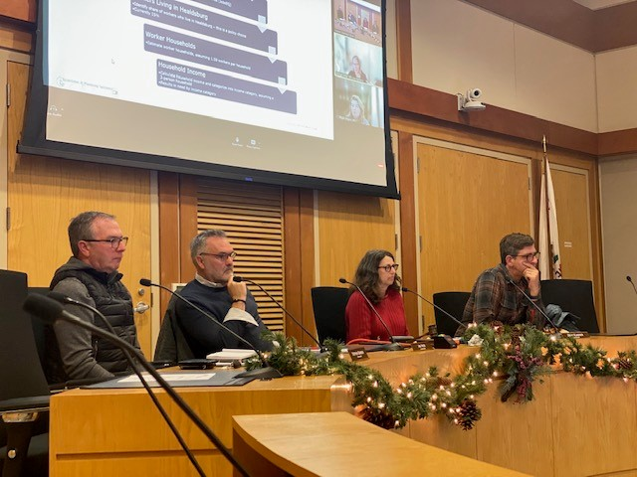
Housing Needs Assessment & Funding Strategy
Progression of the Housing Needs Assessment (HNA)
Contract Approval with EPS Systems INC
Date: September 18, 2023
The City Council initiated the Housing Needs Assessment process by approving a contract with EPS Systems INC.
Methodology Presentation to HEWG and the Public
Date: December 11, 2023
The Housing Element Work Group (HEWG), along with members of the public, received a comprehensive presentation on the methodology planned for developing the HNA.
Upcoming Updated HNA Presentation
Date: January 29, 2024
The HEWG and the public are scheduled to receive an updated version of the HNA. This revision will reflect the feedback and inputs gathered during the December 11th meeting, ensuring a collaborative and inclusive approach to housing needs assessment.

Slide 82
Middle Income Housing and Home Ownership Strategies
The HEWG is engaged with City staff in a study to assess middle-income housing in Healdsburg.
This involves several key actions:
Quantifying the Need: The HEWG is assessing the demand for middle-income housing to accurately understand the scope of the requirement in Healdsburg through the HNA process.
Optimizing Measure P Units: Strategies are being developed to enhance the effectiveness of the City’s Measure P units, ensuring they cater to the needs of middle-income households.
Funding Middle-Income Housing: The HEWG is identifying and recommending funding programs specifically tailored for the development of middle-income housing units.
Expanding Homeownership Opportunities: There is a focus on creating pathways to homeownership for all income levels, aiming to increase access to stable and affordable housing.

Slide 83
Downtown Housing Capacity Study Update
City Council Goal:
Evaluation of existing codes, legislation, and law to identify barriers to, and opportunities for increased housing capacity in Downtown Healdsburg.
Competitive RFP process resulted in selection of Opticos Design
Analyzing 5 sites located within the Downtown Commercial and Service Commercial zoning districts.
Low & high-yield scenarios with site plans, street views, and site visualizations.
Study Sites:
505-535 Healdsburg Avenue – Rite Aid, O’Reilly Auto, etc. – SC District
502 Healdsburg Avenue – Bank of America – SC District
2 North Street – West Plaza City Parking Lot – DC District
456 Healdsburg Avenue – Former Gas Station – DC District
434 Healdsburg Avenue – City Parking Lot – DC District

Slide 84
Downtown Housing Capacity Study Update
Development Assumptions
Building heights
Setbacks
Lot coverage
Floor Area Ratios (FAR)
Density
Parking requirements
Mix of unit types
Next Steps
Site testing
Draft site plan alternatives
Public workshop
Final site plans and site visualizations
Potential housing yield
Report on barriers and recommendations
Council presentation

Slide 85
City Growth Management Ordinance
Established by Voter Initiative in 2000
Modified by the voters over last 24 years
Main Components of GMO: 3-year cycles
Category A – 4 or fewer residential units – (30)
Category B – 5 or more residential units – (60)
Category C – multifamily middle-income units – (150)

Slide 86
Assessment of the City’s Growth Management Ordinance
Healdsburg has changed substantially since the passing of the GMO. The GMO is consistently identified as a key barrier to developing housing that meets the needs of the entire community.
Staff, the HEWG, and other stakeholders have identified potential modifications to the GMO that would increase opportunities for market rate and affordable housing development.

Slide 87
Assessment of the City’s Growth Management Ordinance
Option One: Geographic Exclusion(s)
Staff believe the following geographic exclusions are worth exploring:
Downtown: Area bounded by Grant Street to the north, Mill Street to the south, East Street to the east, and the SMART ROW to the west.
Healdsburg Avenue North: Properties fronting on Healdsburg Avenue from Grant Street at the south to Grove Street (Community Center) at the north.
Central Healdsburg Avenue Plan (Depot Area): Properties within the adopted CHAP boundary.
South Entry Area Plan – Properties within the Healdsburg City limits located east of the Russian River on the other side of the Healdsburg Bridge.

Slide 88
Assessment of the City’s Growth Management Ordinance
Option 2: Remove income restriction on multifamily rental units
Current GMO allows for 150 multifamily units to be built per three-year cycle.
Units are subject to an income restriction at the “middle income” level 120-160% AMI.
Burdensome income verification requirements for tenants that results in participants losing housing security when they are financially successful.
No significant new workforce housing has resulted since creation.
Polling will explore the feasibility of removing the income restriction for rental units only (not for sale).
Staff believe this will unlock the potential of more workforce housing by eliminating the burdensome requirements for developers and tenants.
These units would also be subject to the City's Inclusionary Housing Ordinance.

Slide 89
About FM3
Founded in 1981
Conducts public opinion research and guides strategy for hundreds of projects each year
22 employees between Oakland, Los Angeles and Portland
Completes more than 300+ surveys and 160+ focus groups each year
FM3 has conducted research in Healdsburg since 2012, including surveys on a prior GMO amendment (2016), sales tax measures (2012 and 2020), and community attitudes (2018)

Slide 90



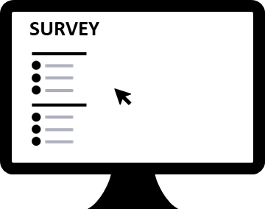
Survey Methodology
Survey Type | 20-Minute Dual-Mode Voter Survey
Research Population | 400 Likely Nov. 2024 Voters in City of Healdsburg
Margin of Sampling Error | ±4.9% at the 95% Confidence Level
Languages | Phone interviews in English and Spanish; online interviews in English only
Contact Methods
Data Collection Modes
Telephone
Calls
Text
Invitations
Email
Invitations
Telephone
Interviews
Online
Interviews

Slide 91





Dual-Mode Voter Survey Technique
FM3 identifies and models the overall voter universe.
FM3 pulls a random sample of stratified clusters of Healdsburg likely voters; each cluster contains voters with similar demographic/geographic characteristics.
FM3 emails those with email addresses
and texts those with cell phones,
inviting them to take the online survey.
FM3 identifies which clusters
have completed online interviews.
✓
✓
✓
✓
FM3 completes telephone interviews with
voters in the remaining clusters to ensure
a representative sample of likely voters.
✓
✓
✓
✓
✓
✓
✓
✓
✓
✓

Slide 92
Survey Research Process
LAUNCH
- Phase 1: Online survey is programmed, tested and launched
- Phase 2: Telephone survey is launched
ANALYSIS
- FM3’s in-house data department processes incoming data
- Initial draft topline results and cross-tabulations are delivered
REPORTS:
- Our in-house graphics team will develop a PowerPoint presentation
- FM3 is available to present to City staff and elected officials
KICKOFF:
- Initial meeting with City, finalize scope of work
- Begin developing questions for survey
DRAFTING SURVEY
- FM3 will work closely with City staff to create, edit, and finalize a survey tool

Slide 93
Questions and Feedback
Thank you!

Slide 94

Public Comment
Comentarios del público

Slide 95
FY 2024-25 & 25-26
Budget Development
Finance Department
January 16, 2023

Slide 96
Proposed Action
Receive a presentation from City staff on the budget development plan for the upcoming two-year budget cycle
Provide feedback and direction to staff on the goals, timeline, and public participation elements of the budget development plan.
Notes:
Before diving right into the Budget timeline and process, I would like to take a moment to provide some context and history about the various revenue sources and uses across the City.

Slide 97
General Fund - Revenues
Notes:
This chart reflects the current Fiscal Year 2023-24 budgeted revenues by source.
For most California Cities property tax is the largest source of discretionary revenues, however, thanks to our vibrant downtown and business community, the City is a Sales tax importer, which means non-residents generate more of our sales tax than residents. As a result, Sales and Use Tax is currently the largest source of revenues in the General Fund at 33% with Property Taxes following closely behind at 28%. Transient Occupancy Tax and Permits & Fees from development are the next largest contributors, representing approximately 7% each.
While Property Tax is a very dependable and inelastic revenue source, Sales Tax, TOT, and development fees are all fairly elastic sources which means they are sensitive to economic conditions and tend to fluctuate more.

Slide 98
General Fund - Revenues
Notes:
This chart shows the past ten years of General Fund Revenues, and preliminary forecasts for the upcoming two-year budget cycle. As you can see revenues have grown tremendously over the years, from about $9M in 2014 all the way to $18M in fiscal year 2024.
The most recent substantial increases over fiscal years 2022 and 2023 were driven largely by TOT growth and the one-time intergovernmental revenues received from the Federal Government as part of the American Rescue Plan Act also known as ARPA.
Looking forward to Fiscal Years 2025 and 2026 we expect the elastic revenue sources of TOT and Sales Tax to remain flat. We expect modest increases in the Other category associated with the new Cannabis Tax, as well as increases in Property tax associated with the first phase of the Mill District Housing development coming line. The North Village developments will help contribute to revenue increases as well as the Enso Senior Living Community and the Appellation Hotel are brought online. Some of this growth is anticipated to be offset with the expectation of Permit and Fee revenues to decrease as development slows.
As a result, overall general fund revenues are anticipated to reflect only modest growth over the next budget cycle.

Slide 99
General Fund – Expenses by Department
Notes:
Moving on to expenses, this chart illustrates General Fund expenditures by Department for the current Fiscal Year. As you can see Public Safety represents the largest portion, collectively expending 63% of the City’s general fund resources. The remaining major players are Finance, City Managers Office and Community Development all using around 11% each.

Slide 100
General Fund – Expenses by Function
Notes:
This chart breaks down the general fund expenses by function. Coincidentally, 63% of the general fund budget supports the wages and benefits of 68 Full Time Employees and 21 Part Time Employees. The next largest category is Internal Service Fees at 14%, which represent the cost of Information Services, Building Maintenance, Fleet, and Insurance. Operational costs including contracted services, supplies and equipment make up another 12%. In Fiscal Year 23-24 7% of the general fund expenses are supporting capital projects, however, most of this is the expenditure of the one-time ARPA revenues.
Looking forward to the next budget cycle, one of the major challenges we will be facing is the rising cost of wages and benefits for employees. We are seeing double digit increases in the cost of medical insurance and the Consumer Price Index for October 2023 in the San Francisco Bay Area was still up 2.8% from the prior year. With several of the MOU’s expiring for our various employment groups there is degree of uncertainty in the magnitude of these impacts.
Other rising costs include liability, property, and workers compensation insurance coverage, CalPERS Unfunded Accrued Liability or UAL costs associated with employee pensions, and equipment and materials costs that have been affected by the record inflation over the lasts few years. It is important to note that these rising costs are not specific to the general funds and will be impacting many of the City Funds discussed tonight.

Slide 101
Measure T – Transactions and Use Tax
Translation Services $35k
Streets $2 M
Capital Projects $3 M
Public Safety Positions $900k
Local Partnerships $120k
Low Income Utility Discounts $63k
Notes:
Measure T is the Cities ½ cent Transactions and Use Tax that is collected on all sales that occur within City limits. This tax is also collected on motor vehicle sales when the vehicle is registered to an address within the City. As you can see in the chart above this revenue has also increased significantly since 2014 growing from about $1.9 M to about $2.9 M.
This funding is currently used to support various public safety positions including the emergency preparedness position and the CORE team. It also supports local partnerships with the Chamber of Commerce and Corazon, as well as Low Income Utility Discounts provide through the CARE program and translation services. A significant portion of this revenue though is currently supporting Streets through operations, maintenance and capital projects including Healdsburg Ave Complete Streets Project and the Grove Street Neighborhood Plan Implementation. The other major capital project completed with this funding in the current year is the Fire Substation.
Looking forward to the budget process, many of these cost are ongoing, so discussions will primarily be focused on prioritizing our capital project needs and balancing the timelines of those projects.

Slide 102
Community Services – Special Revenue Fund
Notes:
Another unique facet of the City of Healdsburg's budget is that the Community Services Department is isolated in its own Special Revenue Fund. This is due to the voter approved Transient Occupancy Tax ordinance that determined 10% of the total 14% tax is restricted to support Community Services. This includes the construction, acquisition, improvement, rehabilitation, management and operations of fields, parks, open space and recreational facilities.
The chart above illustrates the breakdown of the various revenue sources as well as highlights the recent growth in TOT in FY 21-22. While substantial growth in TOT is not anticipated in the upcoming budget cycle, the City is still well positioned to continue the path towards issuing bonds.

Slide 103
Community Services – Special Revenue Fund
Notes:
This Pie chart represents the Fiscal Year 2023-2024 budget expenditures for the Community Services Fund, of which approximately 39% or $3.3 M of the annual Operating budget supports 17 Full Time Employees and approximately 104 part time employees. Another 24% or $2.1M is contributed towards operating expenses and supplies with 18% or $1.6 M supporting capital projects including the Foley Community Pavilion project and Preschool renovations at the Community Center. As reflected in the chart the current budget focuses on large projects and differed maintenance which we plan to continue in the upcoming budget cycle as we shift our focus to the Badger Park Redevelopment Project and the Saggio Hills Park.

Slide 104

Enterprise Funds
Utilities
Water
Sewer
Drainage
Electric
Other Business Type
Airport
Notes:
Enterprise Funds represent Business Type activities, where the City sells services to the public for a fee. This includes the cities major utilities like Water, Sewer, Drainage, Electric, as well as the Airport.
Proposition 218 in CA regulates “Property-related” fees like rates charged for Water and Sewer services. At the next council meeting, Utility director Crowley and I will be providing an update on the current Water and Sewer rate analysis and upcoming proposition 218 process.
The Electric utility is regulated by Proposition 26 and at the end of last fiscal year rates for services through FY 26-27 were established.
A challenge for all the utility funds in the upcoming budget cycle will be the funding and timing of capital projects. The large Healdsburg Ave complete Streets Project requires each of the utilities to complete their underground components prior to the street's activities. Water and Sewer also have additional regulatory impacts and aging facilities that call for capital investments.

Slide 105
Other Funds
Measure S Affordable Housing
L&M Village
Streets
Impact Fees (Various)
Media Center (PEG)
Lighting & Landscape Assessment Districts
Gas Tax
Opioid Settlement
Public Safety
Long Range Planning
Notes:
There are many other funds that will be included in the upcoming budget cycle and this slide lists a few. One new fund on this list I would like to highlight for you tonight, is the Opioid Settlement fund which holds the payouts from the various settlements Council opted into. These funds are restricted for use towards reducing the effects of the opioid epidemic in our community, including prevention, intervention, treatment and recovery. Staff are working with community partners to develop a plan for allocating these funds that will be presented in the budget process.
For addition context, the City has a total of 60 Funds
1 General Fund
5 Internal Service Funds (Insurance, IT, Building, Vehicle Maintenance, Vehicle Replacement)
11 Enterprise Funds (Includes both Operating and Capital)
8 Impact Fee Funds (Fees paid by development for their impact on, water, sewer, electric, drainage, streets, parks, fire, and parking.
4 Trust Funds (Funds the City takes fiduciary responsibility for administering on behalf of a trustee)
31 Special Revenue Funds that represent revenues that are restricted for specific uses like Gas Taxes and the Opioid Settlements.

Slide 106
Timeline
Notes:
The proposed budget timeline before you is color coordinated based on key stakeholders. The green dates signify council engagement and start with tonight’s development overview. The Finance department key deadlines are indicated with the light blue and represent the next milestone scheduled for early February where finance staff distribute all administrative cost estimates to the departments and the department head operational budget development process begins. The purple dates signify public engagement opportunities and start with the launching of the Public Simulation and Prioritize tools, followed closely by the public budget workshop. While we continue to collect feedback from the public, staff will return to council February 20th to present the Mid-Year Financial Update and provide the biennial reviews of the Pension and Surplus policies. Next up, in March, after a full month of collecting community feedback, we will close the online public engagement tools and begin summary and analysis of the feedback. The final color represented is the dark blue/green which signifies the departments deadline for completing preliminary operational and CIP budgets. Shortly after on March 25th, Council will hold its annual strategic goal setting special meeting and in early April Finance staff will begin meeting with department heads and the City manager to complete evaluation of the proposed budgets. Then staff will return to council on April 15th to provide an update on Budget Development and share the results of the public engagement efforts. The final department deadline for all revisions is in late April to provide enough time for Finance to prepare for the Council Budget Workshop Special Meeting on May 13th. After the workshop, staff will return to Council at the regularly scheduled meeting on May 20th to provide the Third Quarter Financial Update that includes estimates to close for the current year. The Final step of the budget development process is budget adoption which is proposed for June 3rd. This strategically leaves the second meeting in June available as a backup to ensure timely adoption in the event of unanticipated delays.

Slide 107
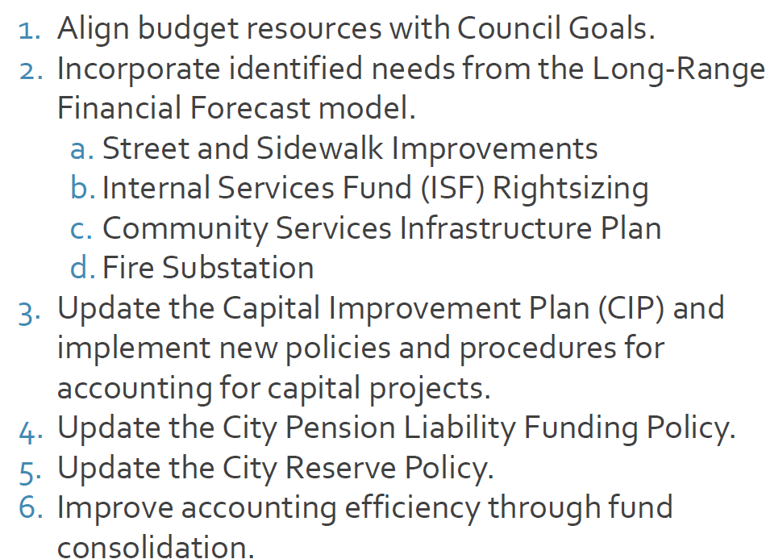
FY 2022-2024 Goals
Notes:
Last year we adopted six budget goals and I wanted to take a moment to highlight some of the major successes. As Council Goal setting is an annual process, this is a continuing goal that we strive to meet, and you will see this as a recurring theme on the next slide. As for the Long-Range Financial Forecast needs, the City made significant contributions towards the Streets and Sidewalk Improvements through ARPA revenue and leveraging grant opportunities on capital projects that will continue to be reflected in the upcoming budget as construction progresses. To facilitate the rightsizing of the Vehicle Internal Service Fund, staff created two separate funds, one for Replacement and one for Services. This now allows the City to perform true-ups to ensure all service costs are paid for by the appropriate departments and allowed the City to emphasize the importance of building funds for future replacements and transition away from primarily pay go funding that results in wide variations of the internal service fees from year to year. The Community Services Department recently presented to Council the Deferred Maintenance Plan which identified several priority projects for the funding allocated in the current adopted budget and outlined additional priorities to consider in the upcoming development process. The Fire Substation Project has begun construction with funding secured from Developers, Measure T and ARPA. The updated accounting practices for CIP projects has resulted in improved transparency, accountability, and administration as demonstrated by the ability of City staff to efficiently shuffle priorities and available funding to fill unanticipated gaps driven by the increased construction costs seen on various projects. The City successfully updated the Pension and Reserve Policies and closed a total of 4 funds that were no longer necessary.

Slide 108
FY 2024-2026 Goals
Align budget resources with Council Goals
Focus on Infrastructure Funding
Complete Facility Needs Assessments
Improve Transparency through Accounting Development
Review Finance Policies
Continue to Pursue Robust Public Engagement
Notes:
Proposed goals for the upcoming Fiscal Years 24-25 and 25-26 budget development process are outlined above. The first goal as previously mentioned is to continue aligning budget resources with Council Goals. The next goal is to focus on Infrastructure Funding. In the current Budget Cycle we have appropriated funds to begin design work on several major Capital Projects including Healdsburg Avenue Complete Streets, Grove Street Neighborhood Plan Implementation, and the Badger Park Redevelopment to list a few. In the upcoming budget development staff will focus identifying additional funding needed to see these projects through construction. Building on last years goals of rightsizing the Internal Service Funds, the City has several aging buildings that are requiring major maintenance. The next budget goal is to complete facility needs assessments to identify future projects for the building maintenance fund that address critical needs as well as functional efficiencies. Number 4 on the list is to improve transparency through accounting development. We have several departments that provide discretionary services that rely on charges for services like Public Works and Community Development. These services and associated revenues are variable over the years and respond directly to market conditions that effect development. Staff intend to update the accounting processes for these costs and revenues to increase transparency and analysis of these discretionary services. Next is to complete the biennial review of the Pension Liability Funding Policy and the General Fund Surplus Policy. Both policies look forward towards long-term goals so it is important to continue to take stock of the current financial situation and update key assumptions as necessary. The final goal is continue to pursue robust community engagement by utilizing feedback and continuing to improve the process.

Slide 109
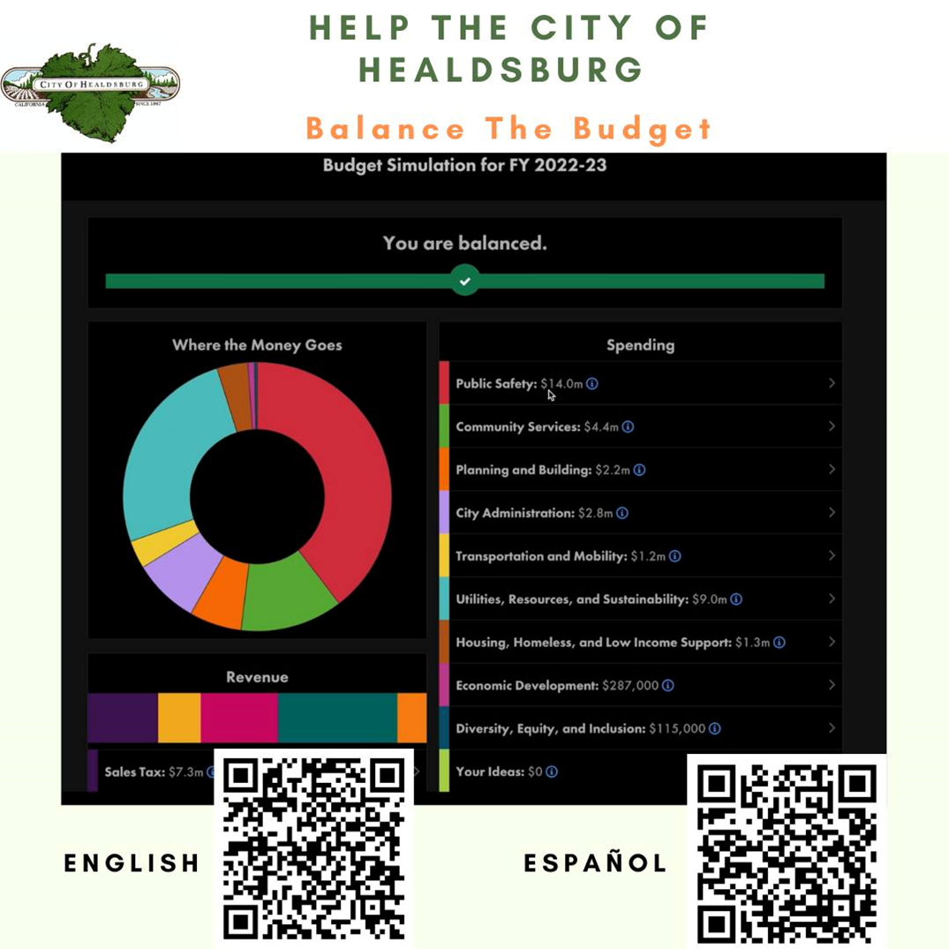
Public Engagement
Notes:
In the last budget cycle, we launched a new public engagement tool, which offered an online budget simulation where the public was asked to make recommendations for the City’s Budget by adjusting spending and revenue across various categories to present a balanced budget.
We had total of 378 submission and 2,519 page views. Based on feedback received, this year we intend on making two versions of the simulation available in both English and Spanish. The first will be an abbreviated version that captures broader feedback and can be completed more quickly, while the second will be a more in-depth version like the simulation launched last year. We hope this approach will continue to make engagement more accessible to the public.
As depicted in the timeline on the previous slide, the launch of the public engagement tools is planned for February 15th. Shortly after the launch staff will hold a Public Budget workshop to engage directly with members of the community. Finance staff is currently coordinating with the Community Services department to secure an optimal location and time for the workshop. Event information will be provided to the Public and Council as soon as it is available.

Slide 110
Discussion, Feedback, Questions, and Direction

Slide 111

Public Comment
Comentarios del público

