Slide 1

District Elections
Public Hearing #6
City Council, April 21, 2025

Slide 2
Recommended Action
Conduct a sixth public hearing to receive community input regarding the proposed final map, Draft Map D, and any other published draft maps and sequence of elections for district-based council elections; and
Select the final map to be included in proposed ordinance; and
Select the two District Seats to be up for election in 2026 (with the remaining District seats to be up for election in 2028) to be included in the proposed ordinance; and
Consider introducing by title only and waive further reading of an Ordinance Amending Healdsburg Municipal Code to Provide for the Election of Members of the City Council by Five Districts; Establish the District Boundaries; and Election Order of Each District.

Slide 3
Background
October 3, 2024: City received a letter from Shenkman & Hughes PC, alleging a violation of the CVRA and threatening litigation unless the City voluntarily transitioned to a district-based election system.
November 18, 2024: Adopted a resolution declaring the intent to transition to District-Based elections.
Conducted the initial two public hearings on December 16, 2024 and January 6, 2025.
Held the third public hearing on February 18th at which both the public and the City Council provided feedback on the draft maps.
Fourth public hearing on March 17, 2025, at which the community and City Council considered draft maps moved forward from the third public hearing, as well as community-submitted maps.
April 7, 2025: Held a fifth public hearing to consider Draft Map A as the basis for an ordinance. Following discussion, the Council elected not to approve Draft Map A and instead selected Draft Map D as the foundation for the ordinance.

Slide 4
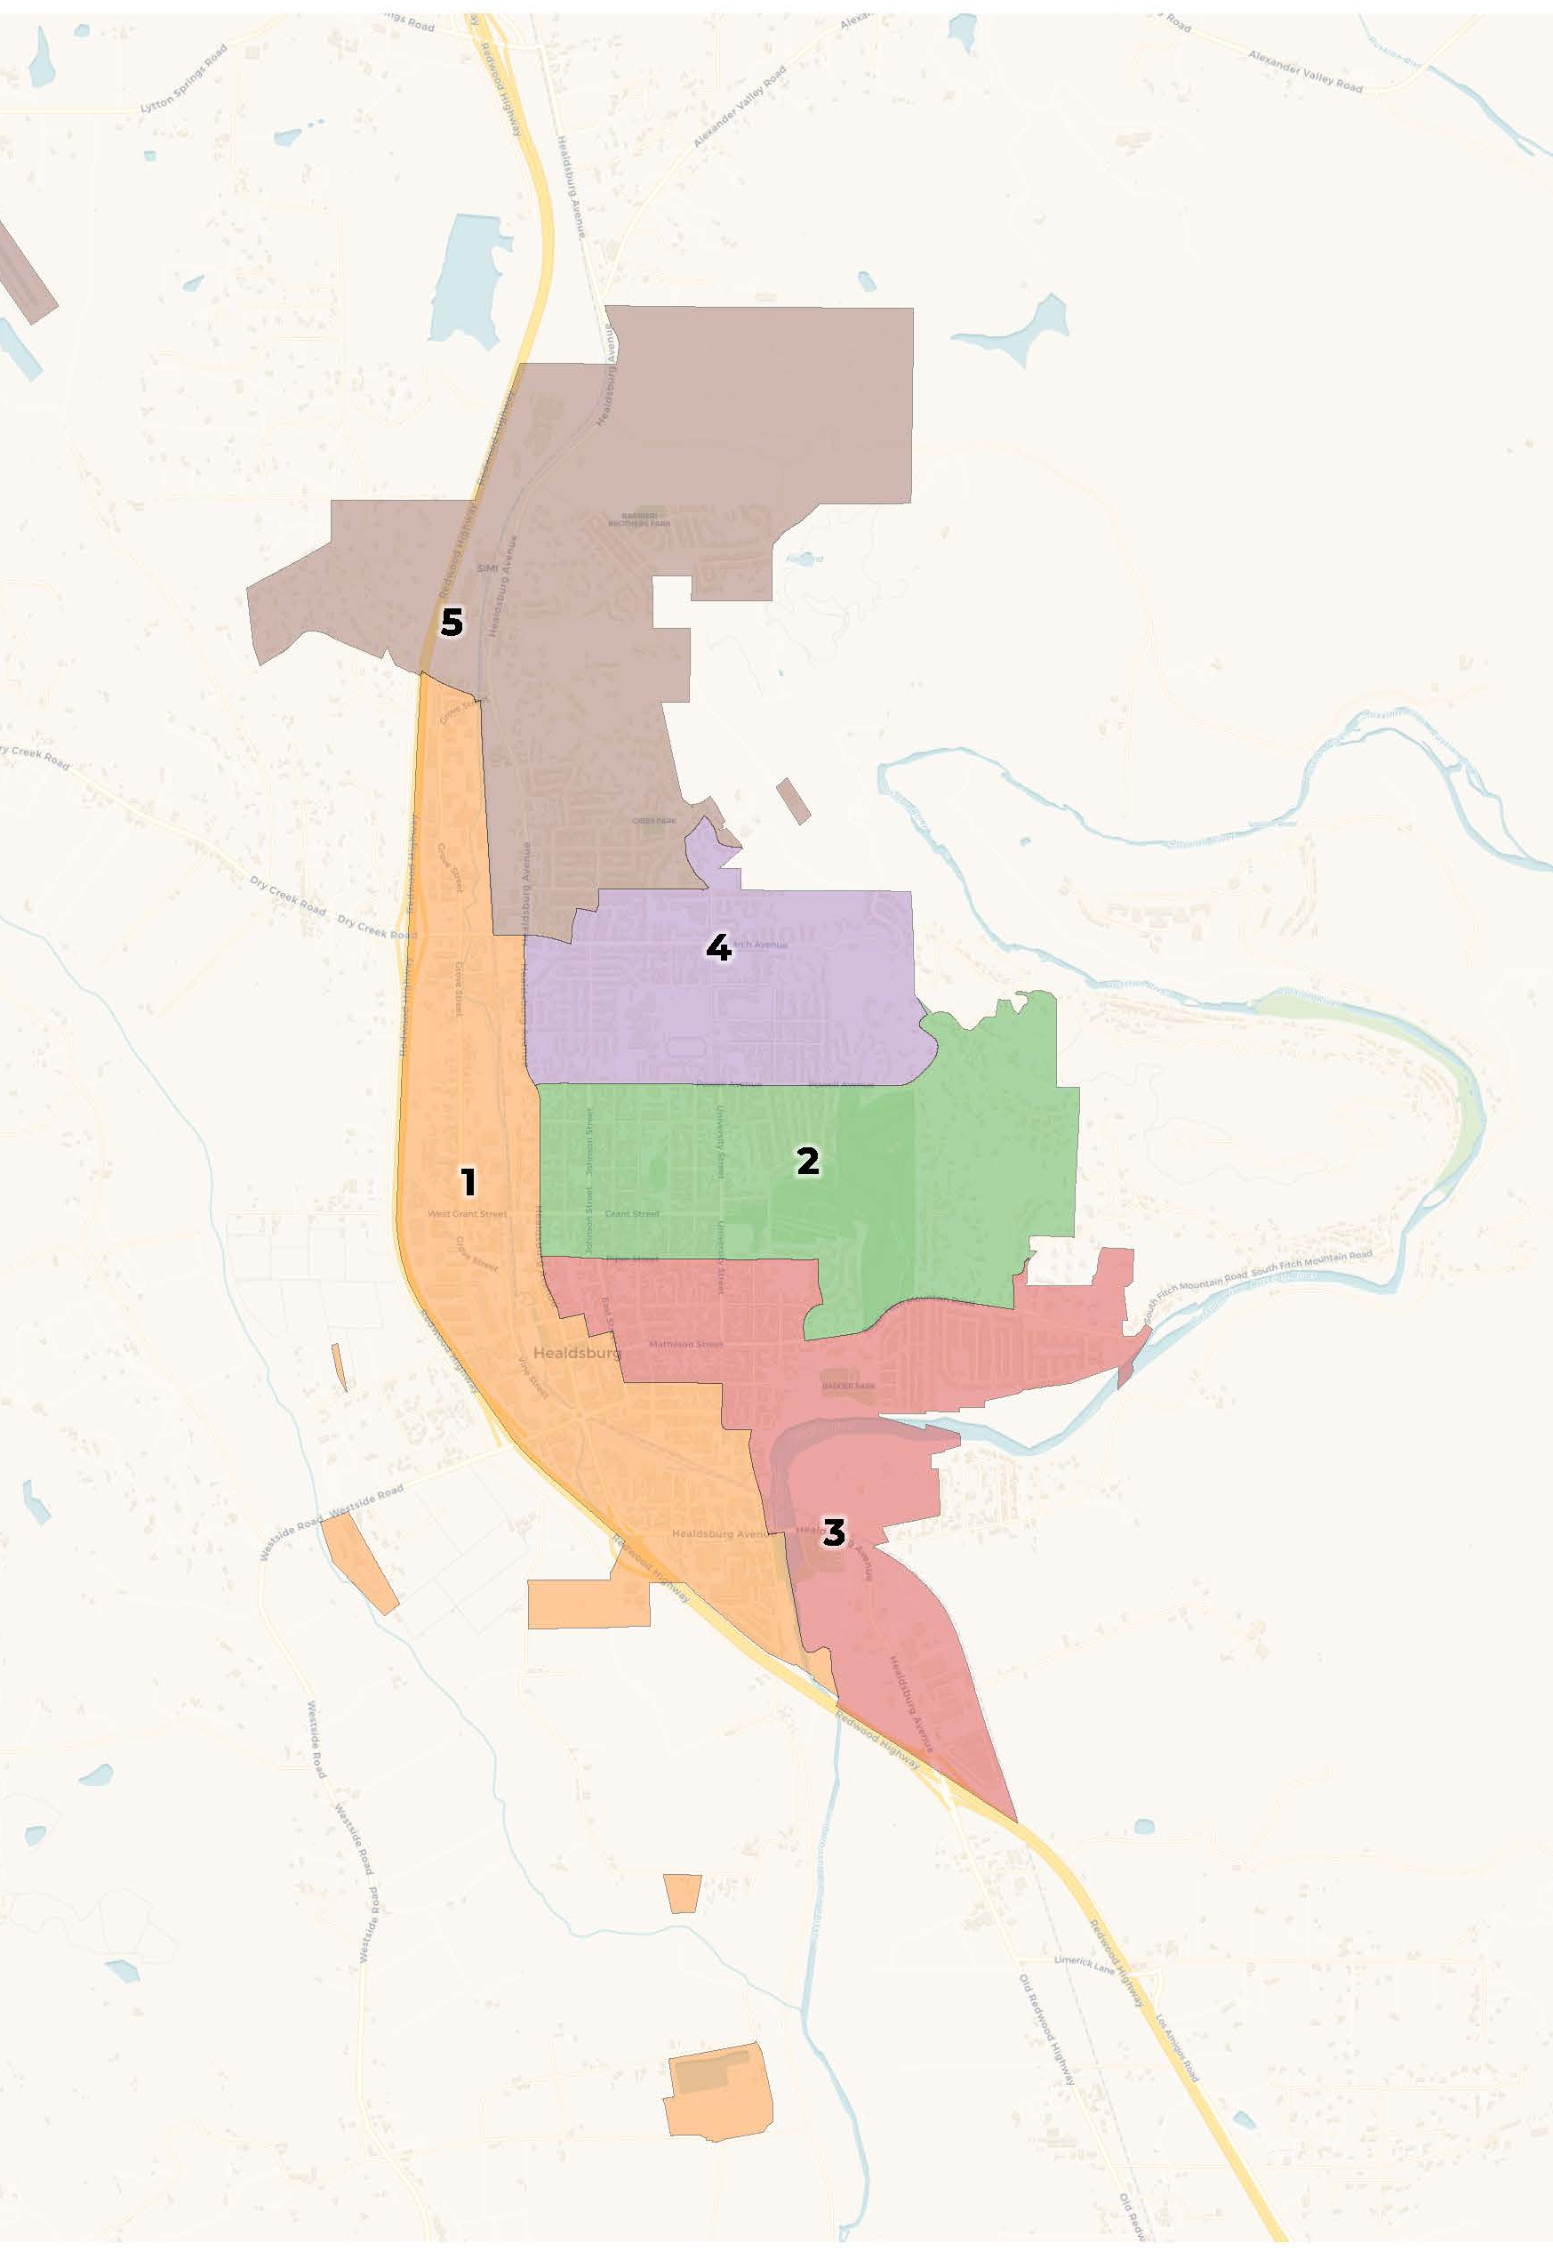
Potential Final Map: Draft D
Total Popoulation Deviation: 6.3%
Cohesive along the river community in the south of the City
Matheson Street Historic District remains together
Similar community north of South Fitch Mountain Road kept together
District 1 maintains similar communities
Establishes an influence district for Latino voters
March Avenue and Fitch Mountain Villas neighborhoods remain together

Slide 5
Recommended Action
By motion, select the final map to be included in proposed ordinance.

Slide 6
Sequencing of Elections

Slide 7


Slide 8
Recommended Action
By motion, select the two District Seats to be up for election in 2026 (with the remaining District seats to be up for election in 2028) to be included in the proposed ordinance.

Slide 9
Recommended Action
Consider introducing by title only and waive further reading of an Ordinance Amending Healdsburg Municipal Code Article 1 (General Provisions) within Chapter 2.40 (Elections) of Title 2 (Administration and Personnel) to add section 2.40.010.01 “District Elections” to Provide for the Election of Members of the City Council by Five Districts; Establish the District Boundaries; and Election Order of Each District.

Slide 10
Questions

Slide 11
